Slide 1
Rapid Prototyping by Machining
Sanjay Sarma

Slide 2

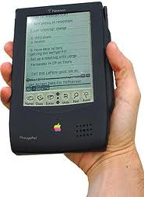


Back in the 90’s

Slide 3
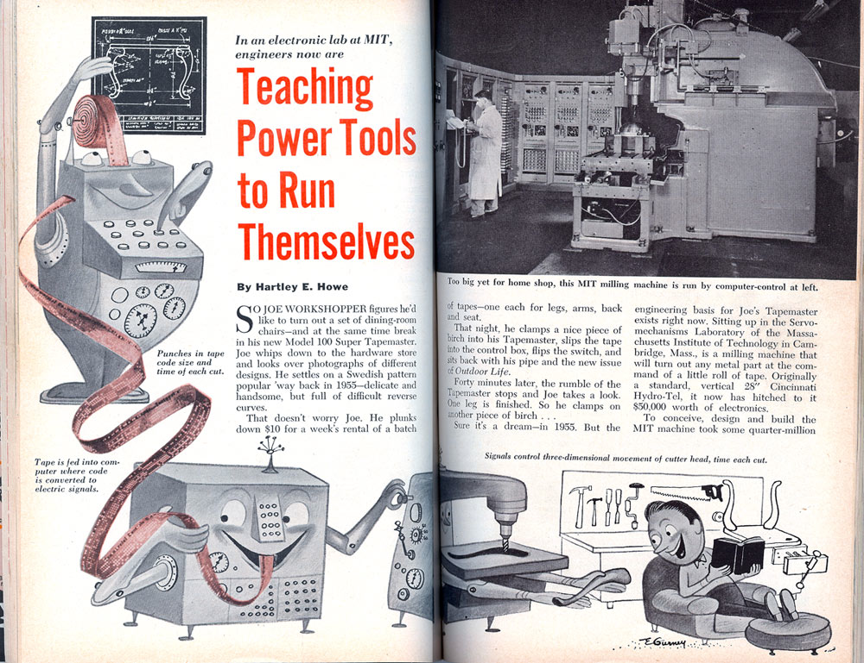
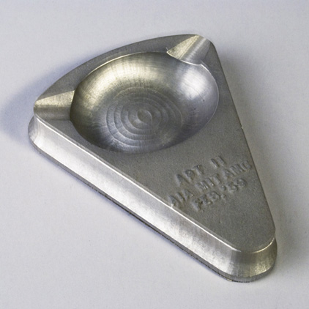
Our Dream
Art-to-Part Machining
Our words for rapid prototyping by machining
Remember, NC was invented at MIT
www.turkcam.com

Slide 4
Our Approach in 1996
Rapid 5-axis tool path generation
Automatic fixturing
New machine tool

Slide 5
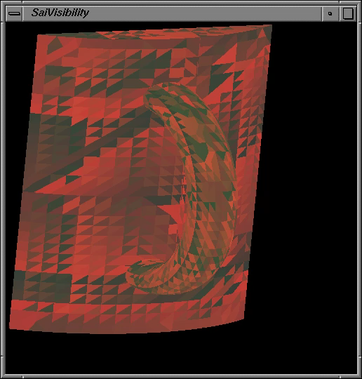
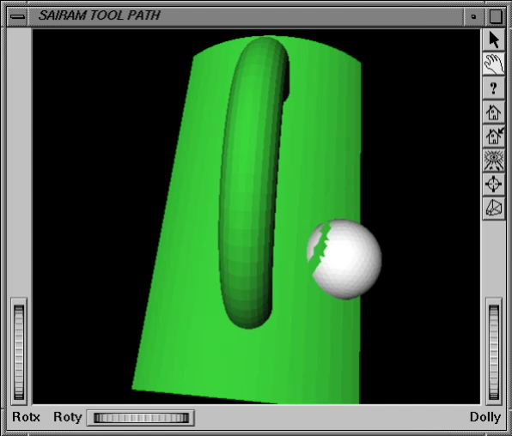
Visibility Analysis
Balasubramaniam, Mahadevan, Sanjay E. Sarma, and Krzyztof Marciniak.
"Collision-free finishing toolpaths from visibility data." Computer-Aided Design 35, no. 4 (2003): 359-374.

Slide 6
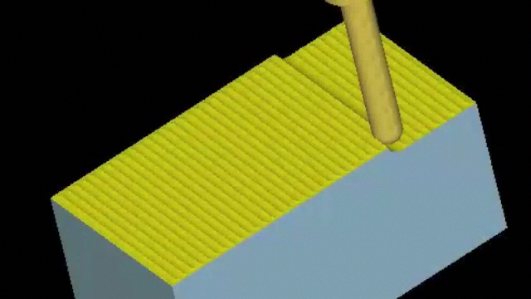
Tool Path Generation

Slide 7
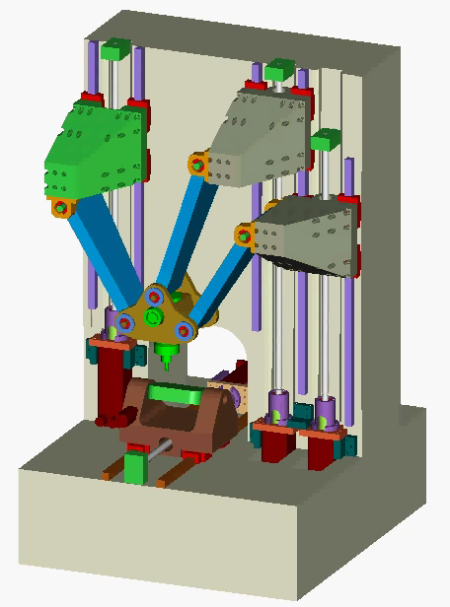
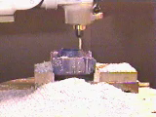
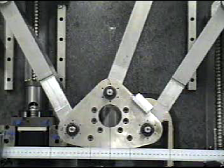
Machine
Tool
Son, Seungkil, Taejung Kim, Sanjay E. Sarma, and Alexander Slocum.
"A hybrid 5-axis CNC milling machine." Precision engineering 33, no. 4 (2009): 430-446.

Slide 8
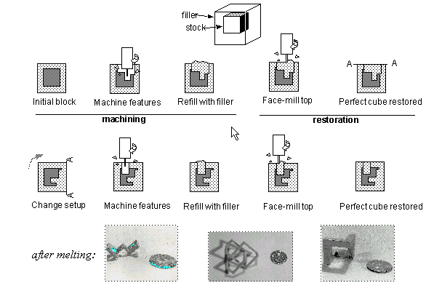
Reference Free Part Encapsulation
Lee, Elmer, and Sanjay E. Sarma. "Reference free part encapsulation: Materials, machines and methods." Journal of Manufacturing Systems 26, no. 1 (2007): 22-36.

Slide 9
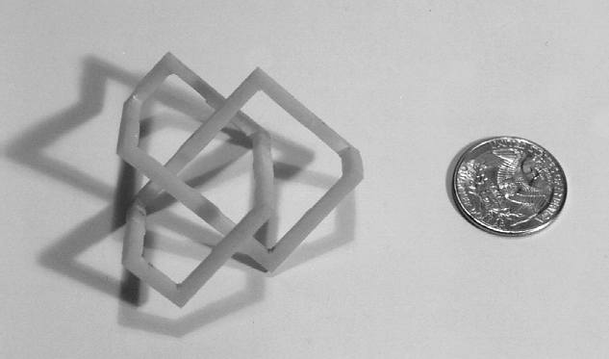
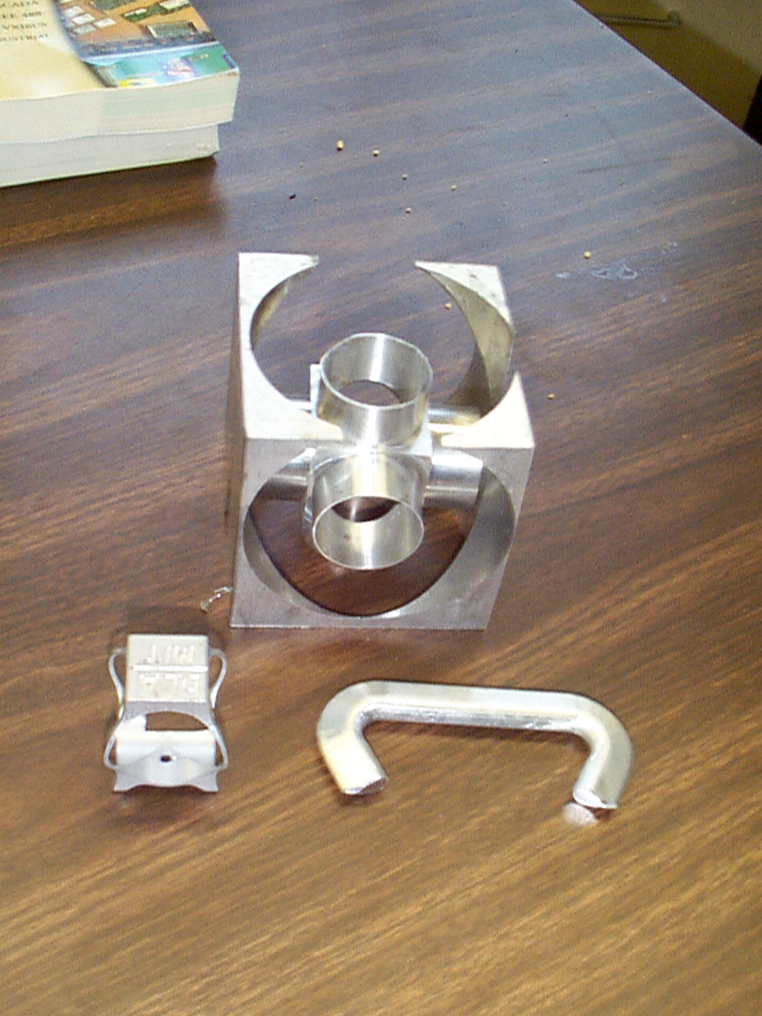
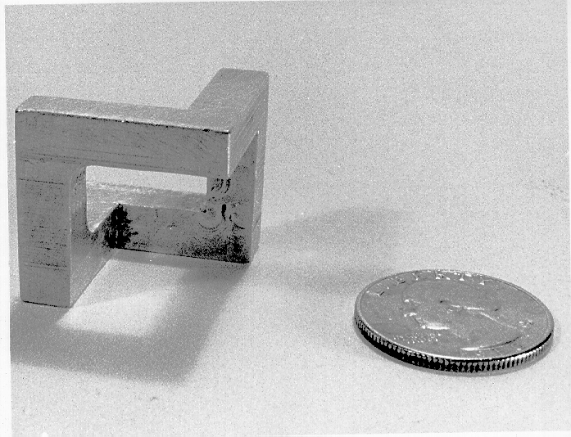
Parts

Slide 10

Looking Back
All the pieces of Art-to-Part Machining in Place
Manufacturing flight to Asia
Let’s party like the 90’s again

