Slide 1
Optics
Prof. J. A. Finnegan
Computer Science Department
Oceanview University, Kansas 66045

Slide 2
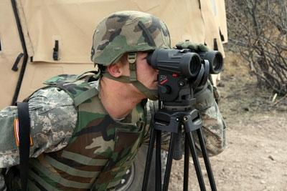
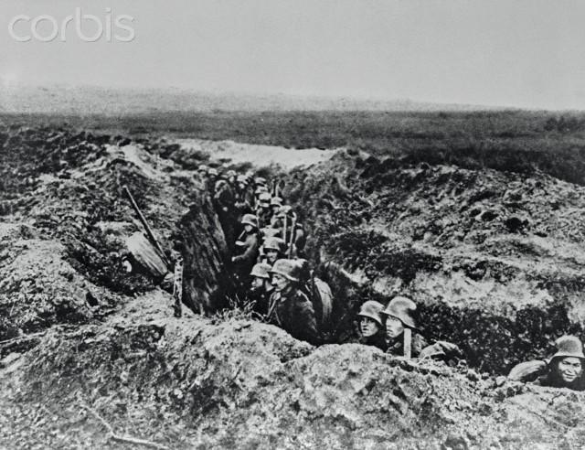
The
Challenge
Our Special Forces have two dual problems:
* Seeing the enemy
* Hiding from the enemy

Slide 3
The
Challenge
Our Special Forces have two dual problems:
* Seeing the enemy
* Hiding from the enemy
The former is solved
by projecting LASER energy on the enemy
The latter is solved
by projecting DASER energy on ourselves

Slide 4
The Devices
LASER is
Light Amplification by Stimulated Emission of Radiation
DASER is
Darkness Amplification by Stimulated Emission of Radiation
For further tuning the above are augmented by
LEDs (Light Emitting Diodes) and
DEDs (Darkness Emitting Diodes).
The DASER and DEDs follow the dynamic principles implemented in active noise canceling headsets.

Slide 5

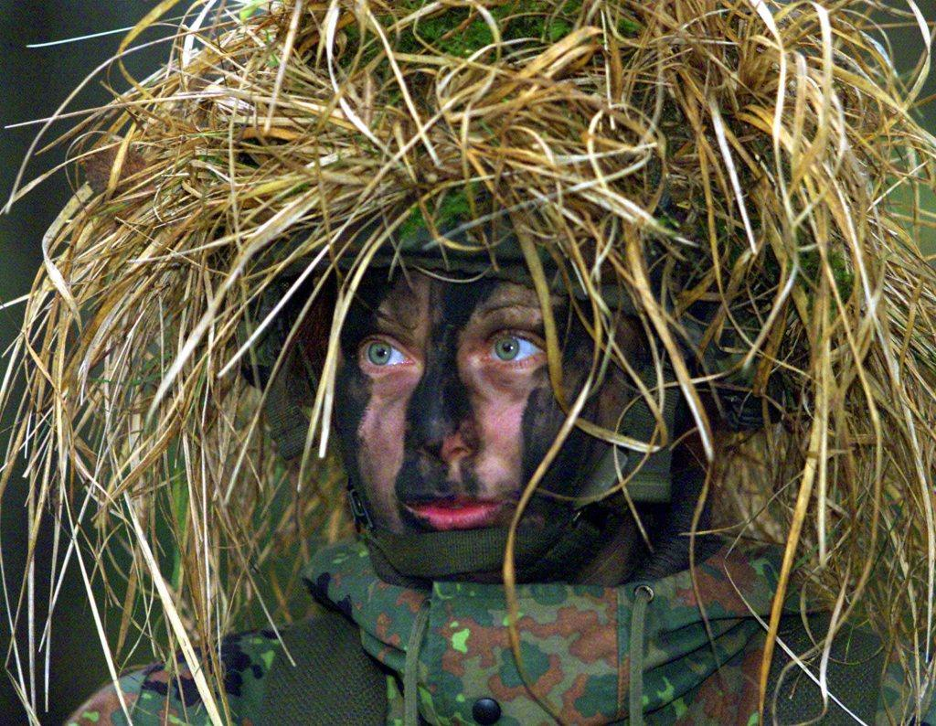
Camouflage
Theoretically limited
and you look silly

Slide 6
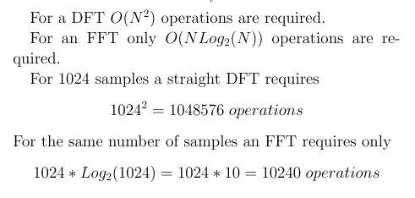
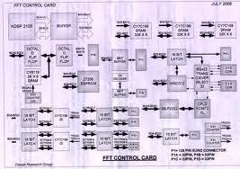
Key
Insight
FFT!

Slide 7
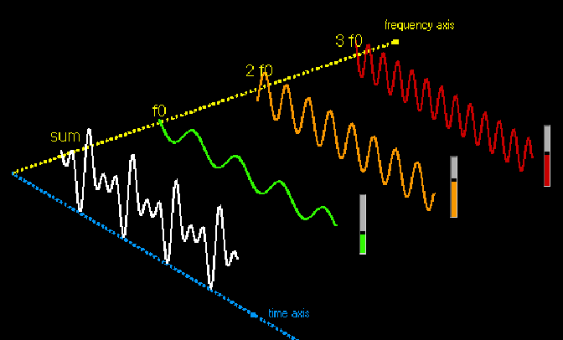
The Frequency
Domain!
All we have to do in order to
conceal objects during daytime is:
(1) Sense our self-image and FFT it
(2) Reverse the coefficients of the FFT'd image
(3) Integrate original image with the FFT'd one
(4) Auto-project the modified auto-image upon ourselves

Slide 8
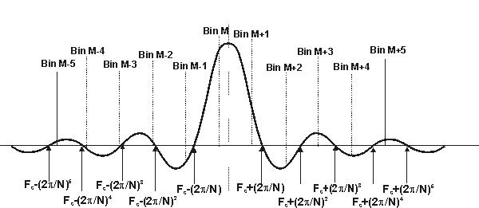
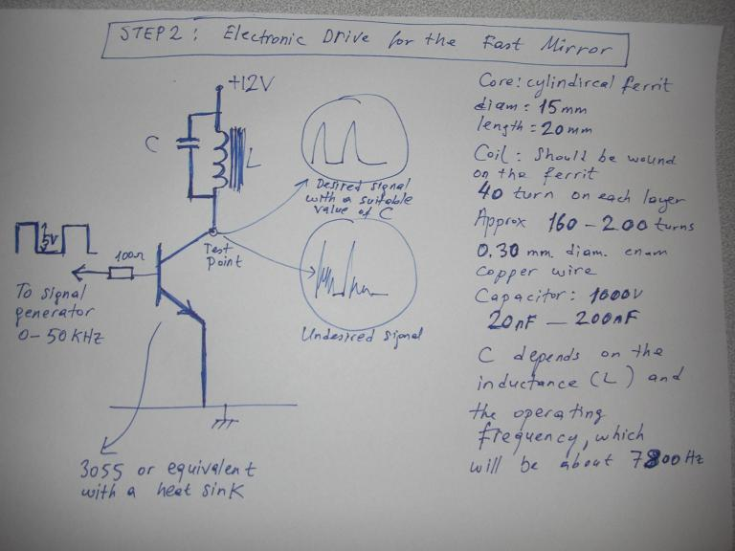
More details

Slide 9
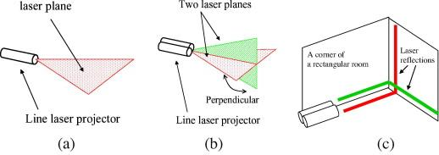
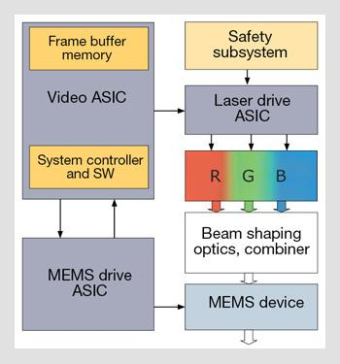
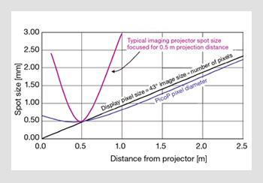
Block Diagram
Derivative helps to find Optimum at 0.5

Slide 10
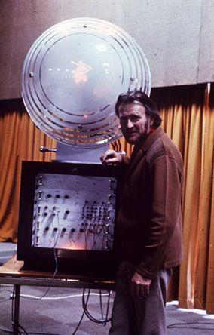
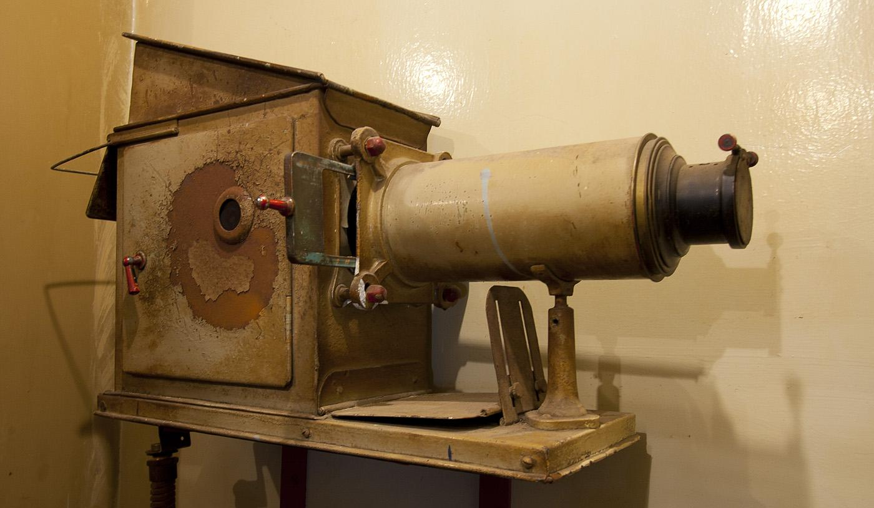
Refined the Ideas into
Initial Production Versions
Projector
Imager and FFT Adder

Slide 11
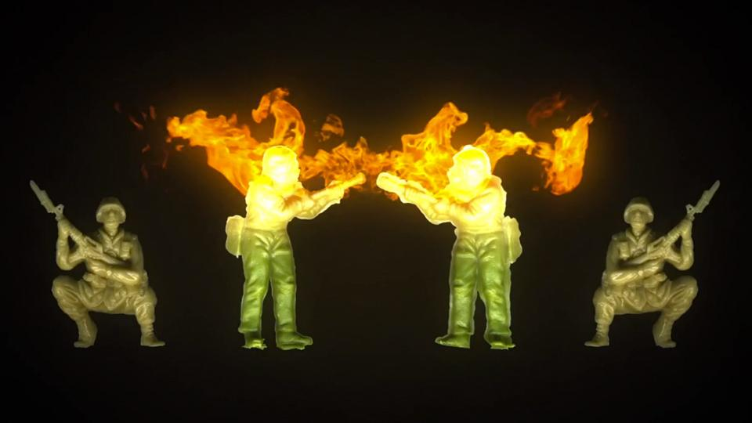
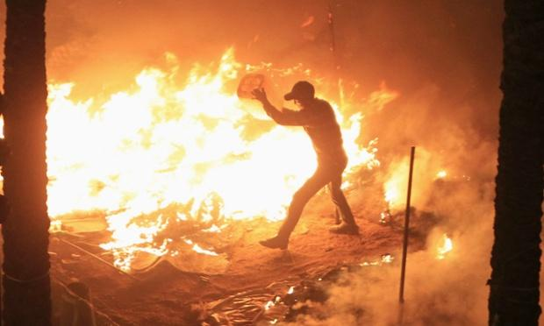
First test - Success! but need to reduce the transmit power

Slide 12
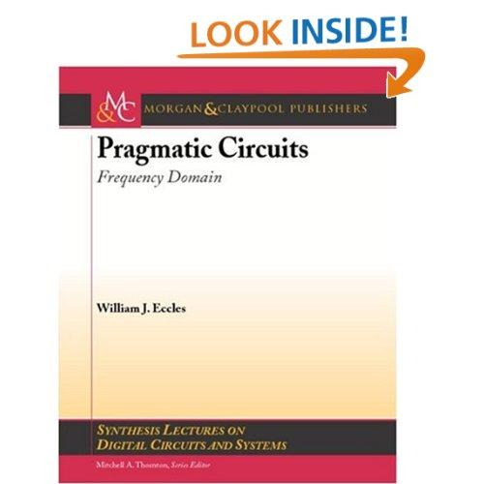
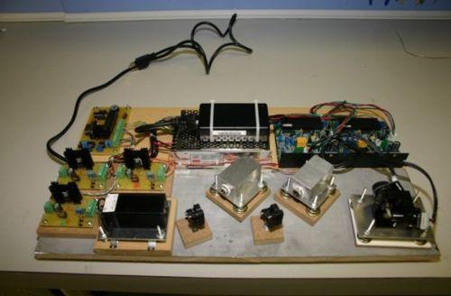
Back to the drawing board

Slide 13
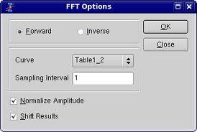
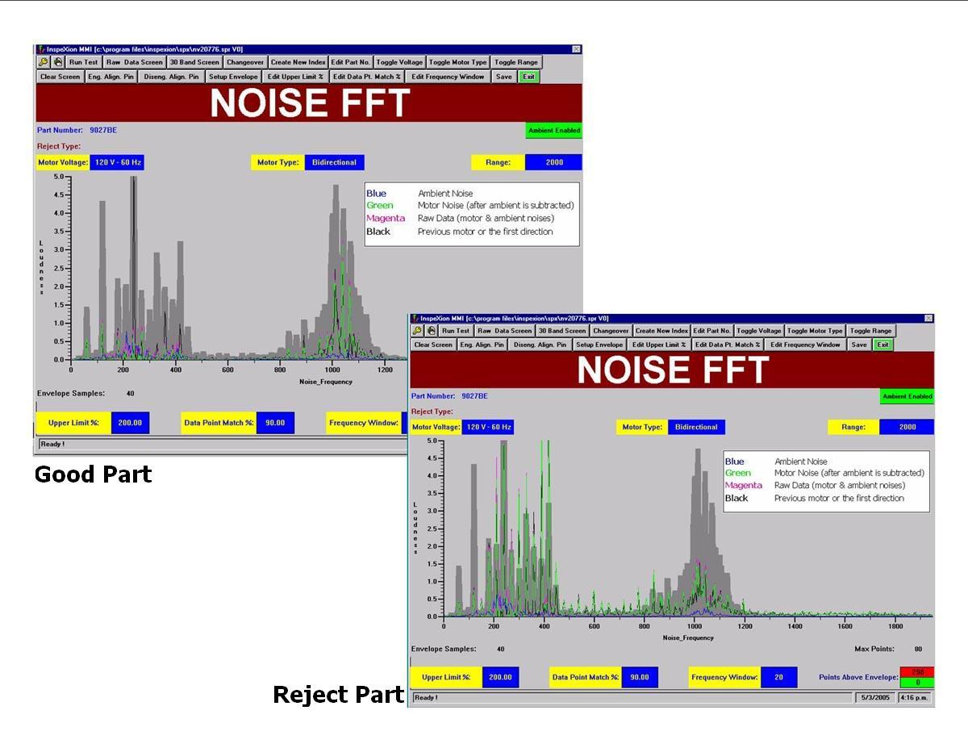
Second Key Insight -
Needed a Windows Implementation

Slide 14

Contract called for two sizes
Handheld
2 AA batteries included

Slide 15
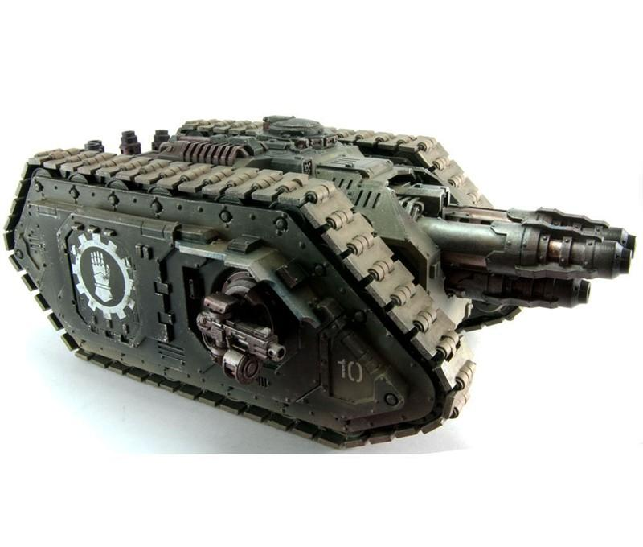
Contract called for two sizes
Handheld
Tankheld
30MW
2 AA batteries included
25,000,000 AA batteries not included

Slide 16
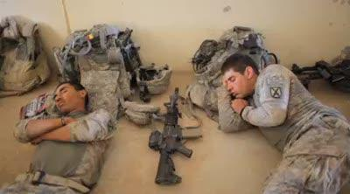
Now, our soldiers can rest easy.
No worries about camouflage!

Slide 17
Thank you
http://labs.oracle.com/people/prof.finnegan/

Slide 18
Key Insight

Slide 19
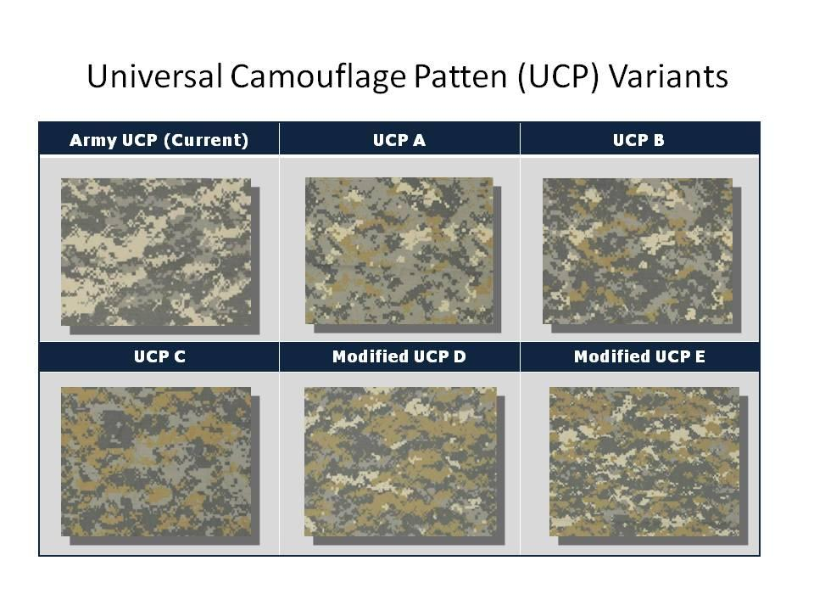

Slide 20
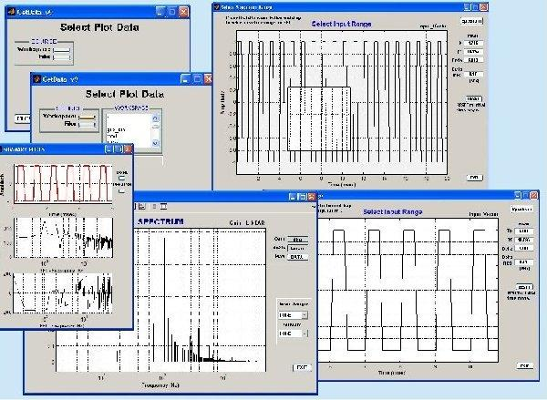
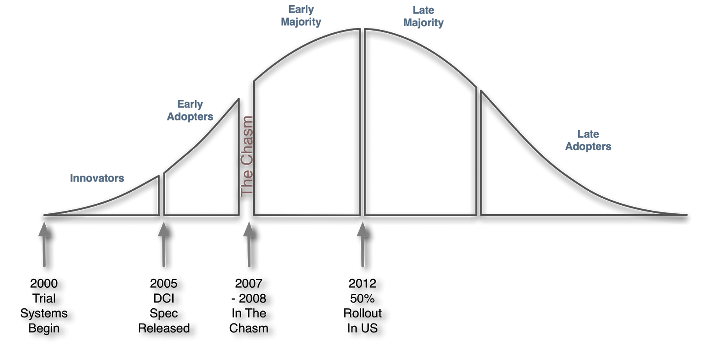

Slide 21
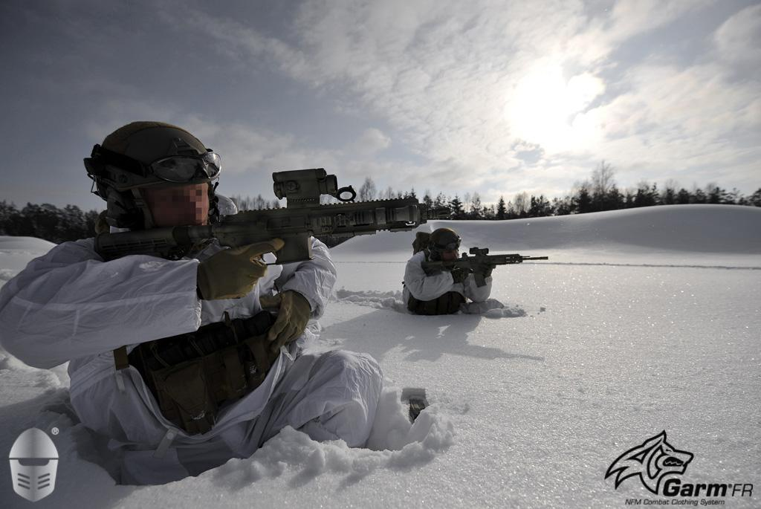
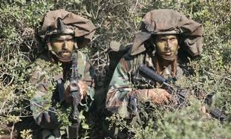

Slide 22
