Slide 1


Under the Hood at Instructables
Fab 8
Saul Griffith, Ph.D., Eric J. Wilhelm, Ph.D.
Instructables.com Founders
Bridget McKendry
Instructables Author

Slide 2
Storyline
Introduction to Instructables
Introduction to an author
Future vision for Instructables and how we can help Fab Labs
2

Slide 3
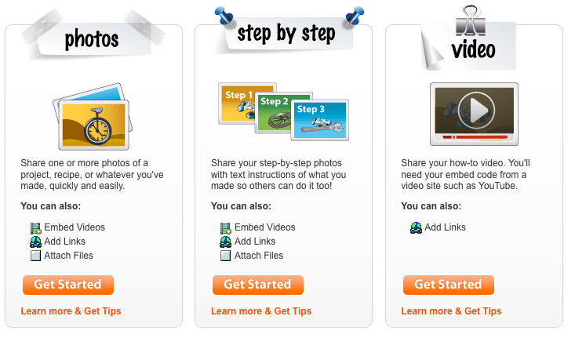
What is Instructables?
Instructables.com is a community for people who like to make things
We enable passionate, creative people to share their most innovative projects, recipes and ideas with our highly engaged audience
Expert driven content: 25k published authors who have created and shared an Instructable
Popular categories and channels: Food, Living, Outdoors, Play, Technology and Workshop
3

Slide 4



Wide variety of topics
Food
Living
Outdoors
Pasta • Salad • BBQ
Bread • Cocktails • Canning
Beverages • Soups • Dessert
Pizza • Snacks • Vegetarian
Craft • Sewing • Holiday
Decorating • Fashion • Art
Kids • Jewelry • Gardening
Green • Kitchen • Pets
Skateboarding
Bicycles • Boats • Kites
Knots • Snow • Survival
Water • Camping
Technology
Workshop
AppleArduinoArtAudioCell PhonesClocksCNCComputersElectronicsGadgetsLaptopsLasersLedsLinuxMicrocontrollersMicrosoftPhotographyRemote ControlReuseRobotsScienceSensorsSoft CircuitsSoftwareSolderingSpeakersSteampunkToolsUSBWebsitesWireless
CarsCompostEnergyFurnitureHome RenovationHome TheaterLightingMetalworkingMotorcyclesOrganizingPest ControlRain BarrelsRepairSolarToolsWoodworking
Play
Technology
Workshop
PSP • Music • Puzzles • Wii
Magic Tricks • Rockets • Xbox
Instruments • Pranks & Humor
Card Games • K’NEX • Lego
Arduino • CNC • Electronics
Lasers • LEDs • Science • USB
Software • Audio • Computers
Reuse • Robots • Cell Phones
Cars • Energy • Furniture
Woodworking • Solar • Repair
Motorcycles • Compost • Tools
Home Renovation • Lighting
4

Slide 5
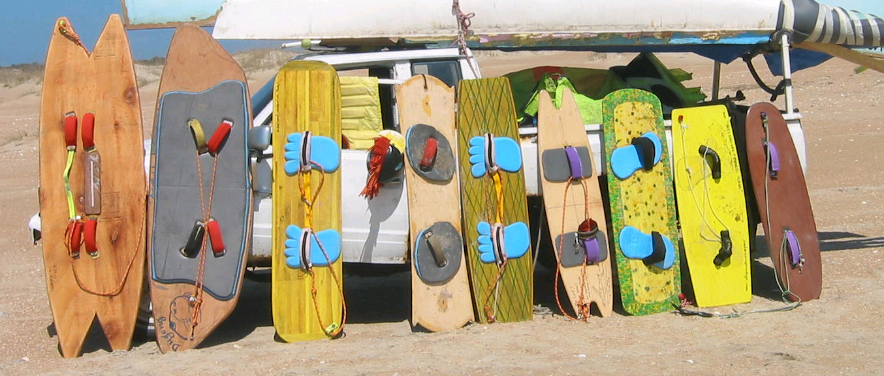
The Story of Instructables
http://www.instructables.com/id/How-to-Start-a-Business-1/

Slide 6
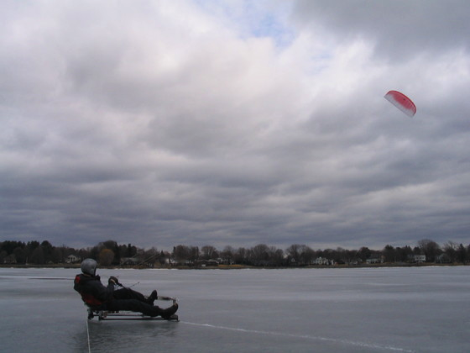
The Story of Instructables

Slide 7
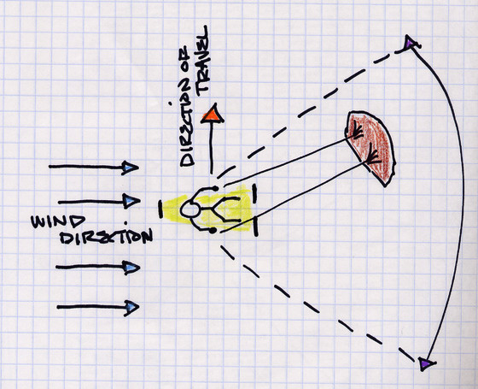
The Story of Instructables

Slide 8
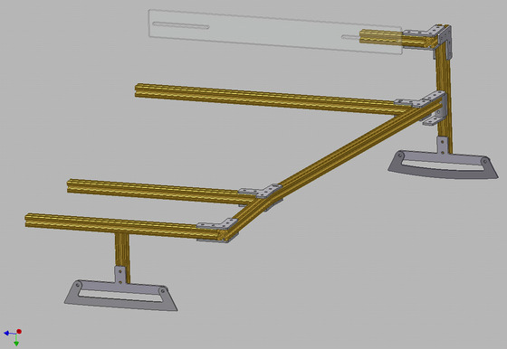
The Story of Instructables

Slide 9
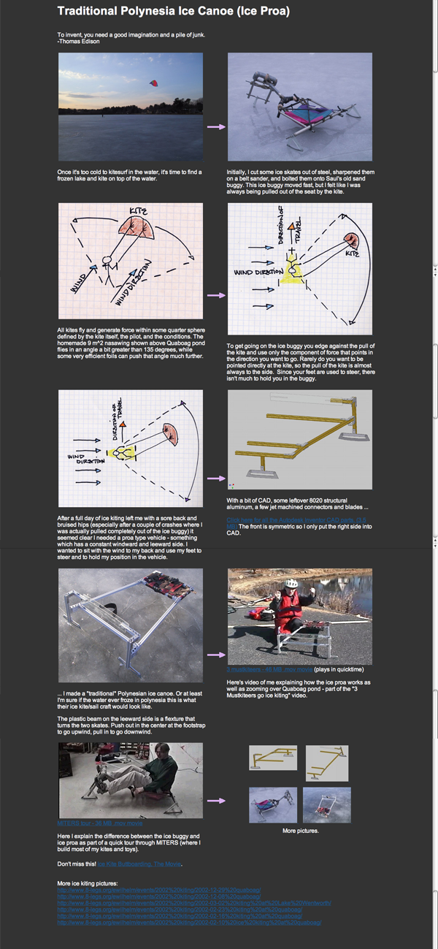
The Story of Instructables

Slide 10
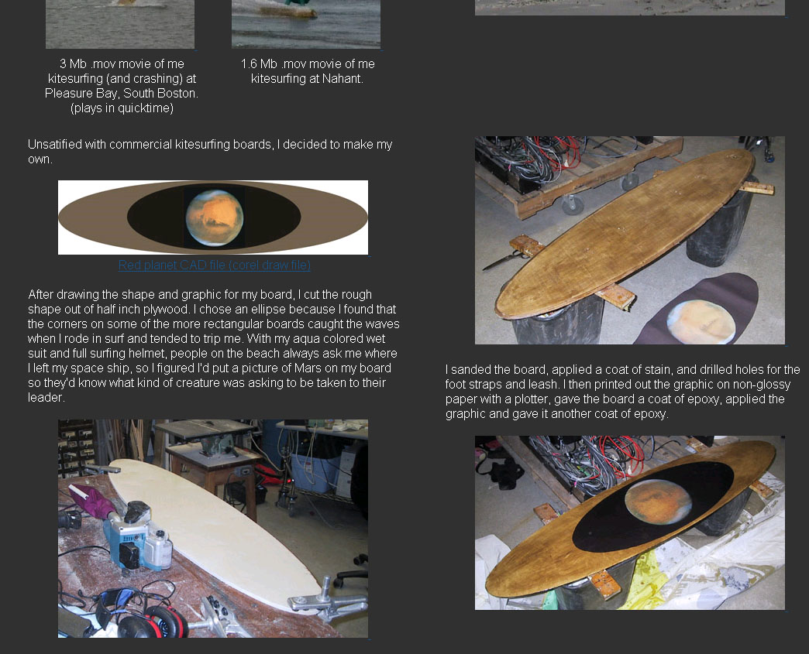
The Story of Instructables

Slide 11
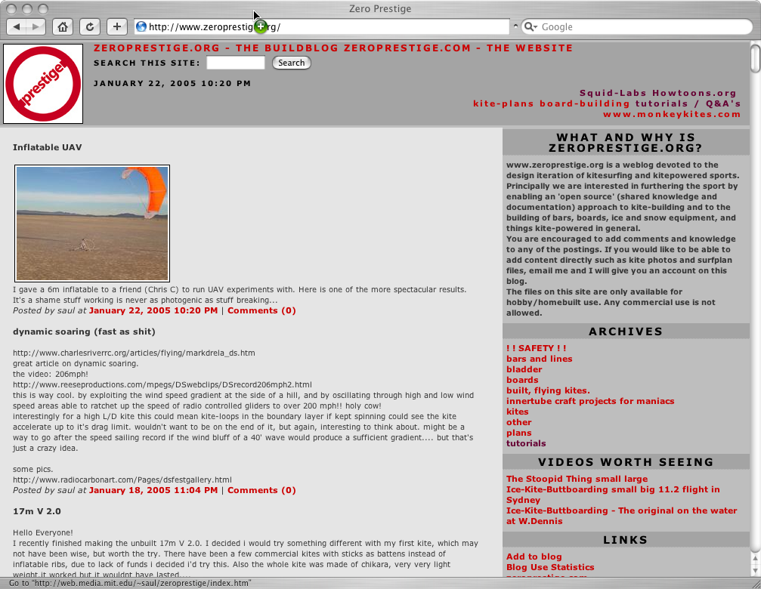
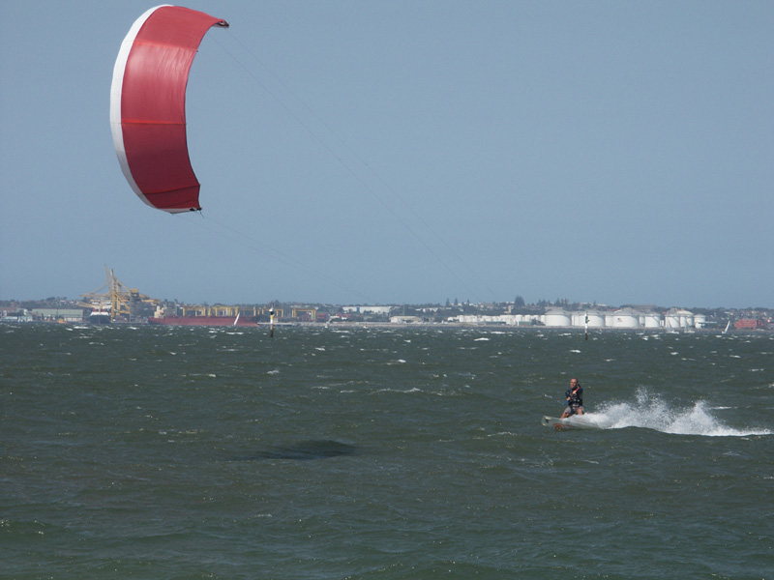
The Story of Instructables
Zeroprestige.org – Open-source approach to kite and kite- powered vehicle design; more than 400 kites built from plans.

Slide 12
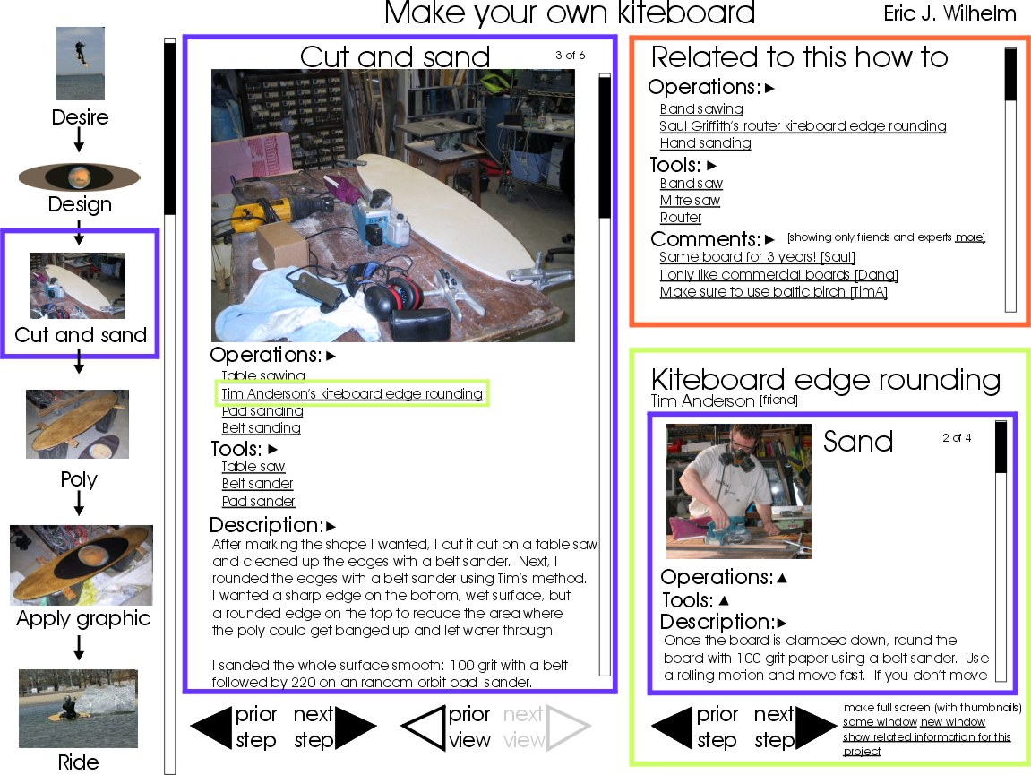
Instructables Wireframe

Slide 13
Launched with 30 or our projects

Slide 14
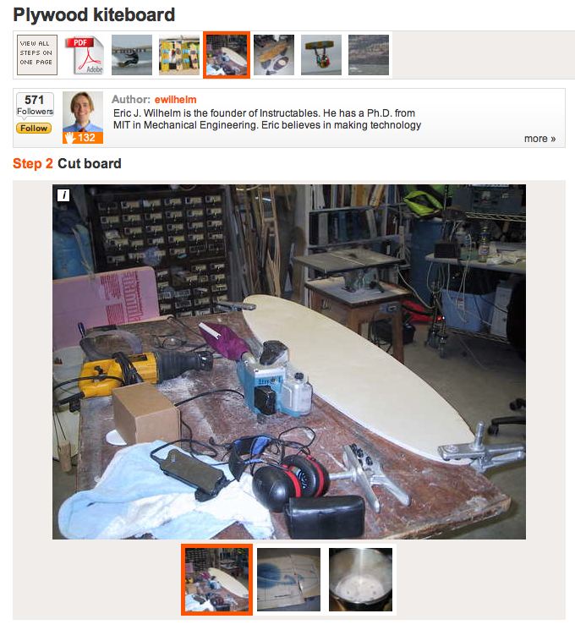
Grew rapidly

Slide 15
Instructables by the numbers

Slide 16
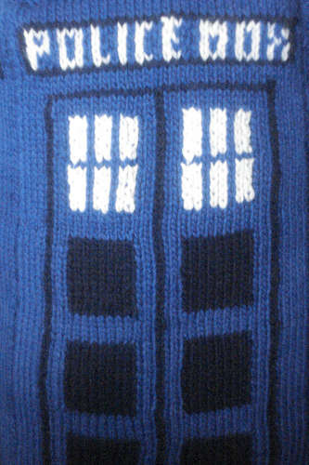
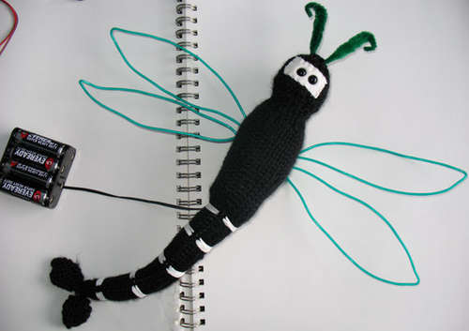
Introduction to Pixelbrid

Slide 17
Introduction to an author
How did you find Instructables?
First impressions?
What convinced you to share you first Instructable?
What connections have you made via Instructables?
2

Slide 18
Future vision for Instructables
Instructables was acquired by Autodesk in 2011.
Instructables is powering communities for several Autodesk products.
2

Slide 19
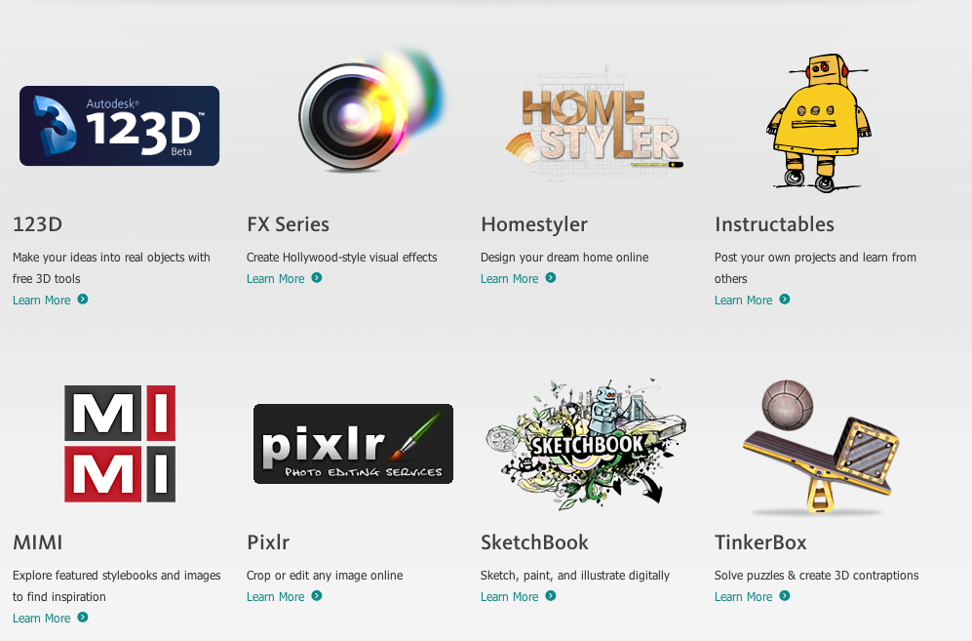
Autodesk consumer products
2

Slide 20
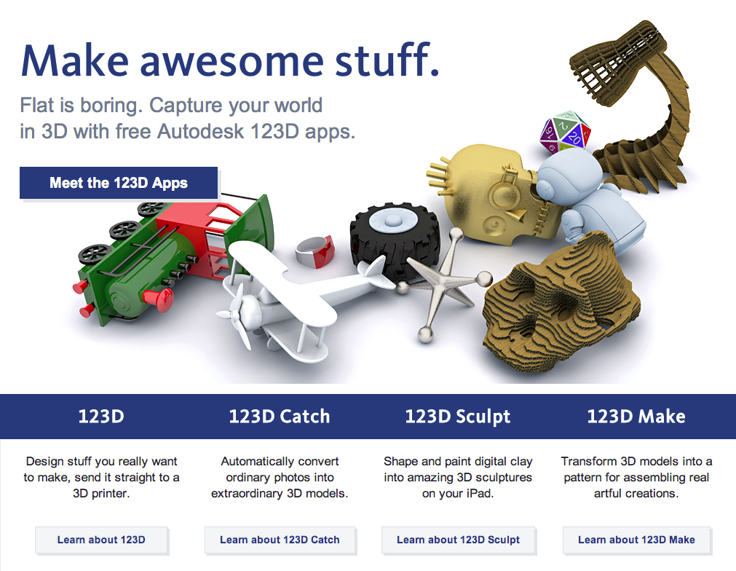
123D
2

Slide 21
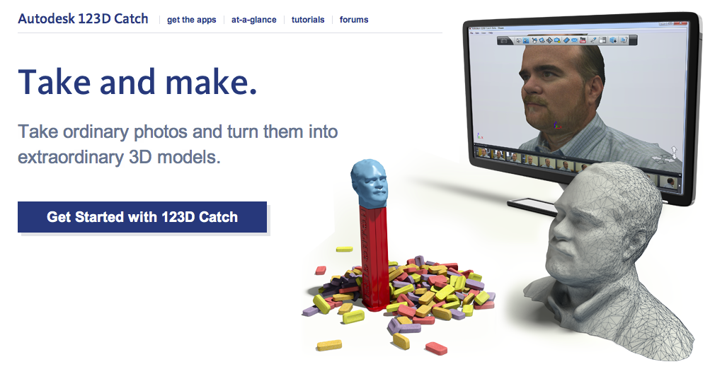
123D Catch
http://www.youtube.com/watch?v=6aU2s85Zw3A
2

Slide 22
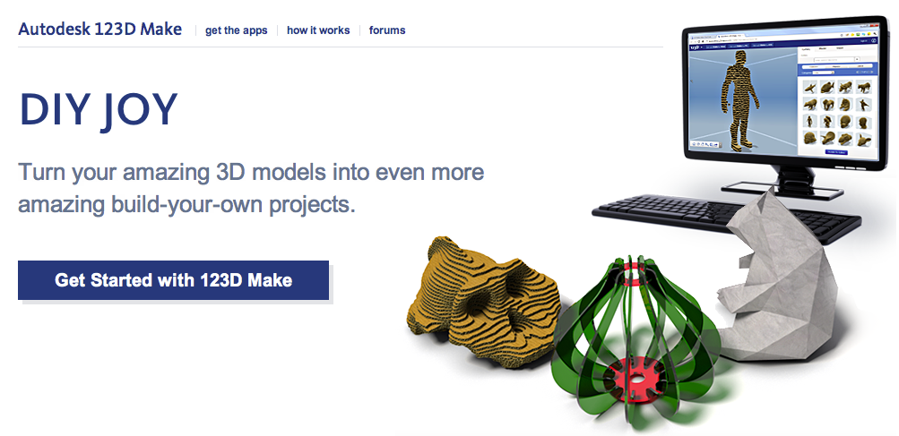
123D Make
http://www.youtube.com/watch?v=jo5TxtKLmjM
2

Slide 23
How we can help Fab Labs have more impact
Groups
Sponsorships
Artist-in-residency
2

Slide 24
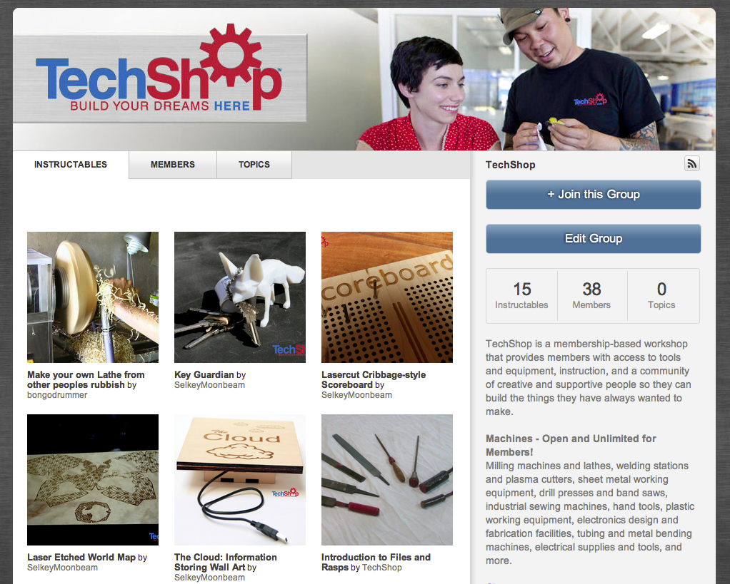
Groups
http://www.instructables.com/groups/techshop
2

Slide 25
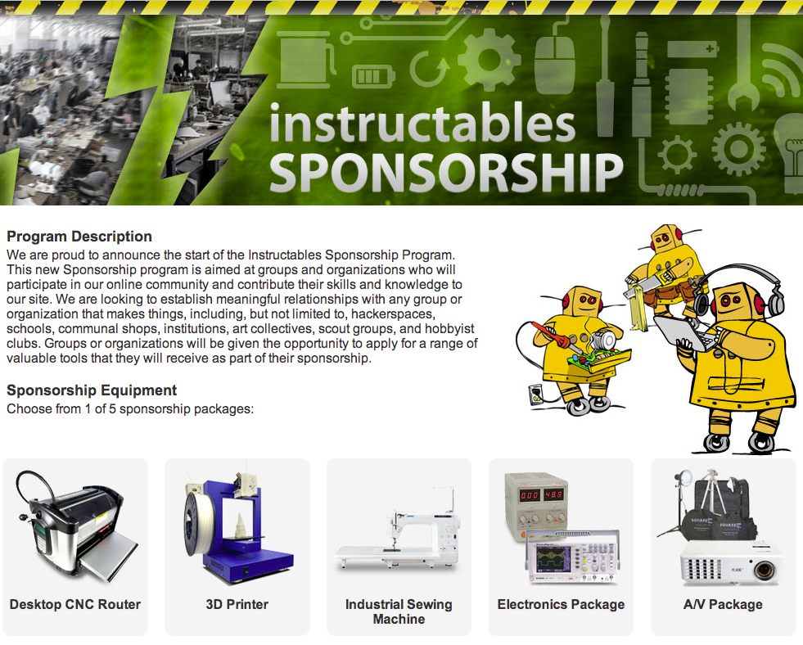
Sponsorships
http://www.instructables.com/sponsorship/
2

Slide 26
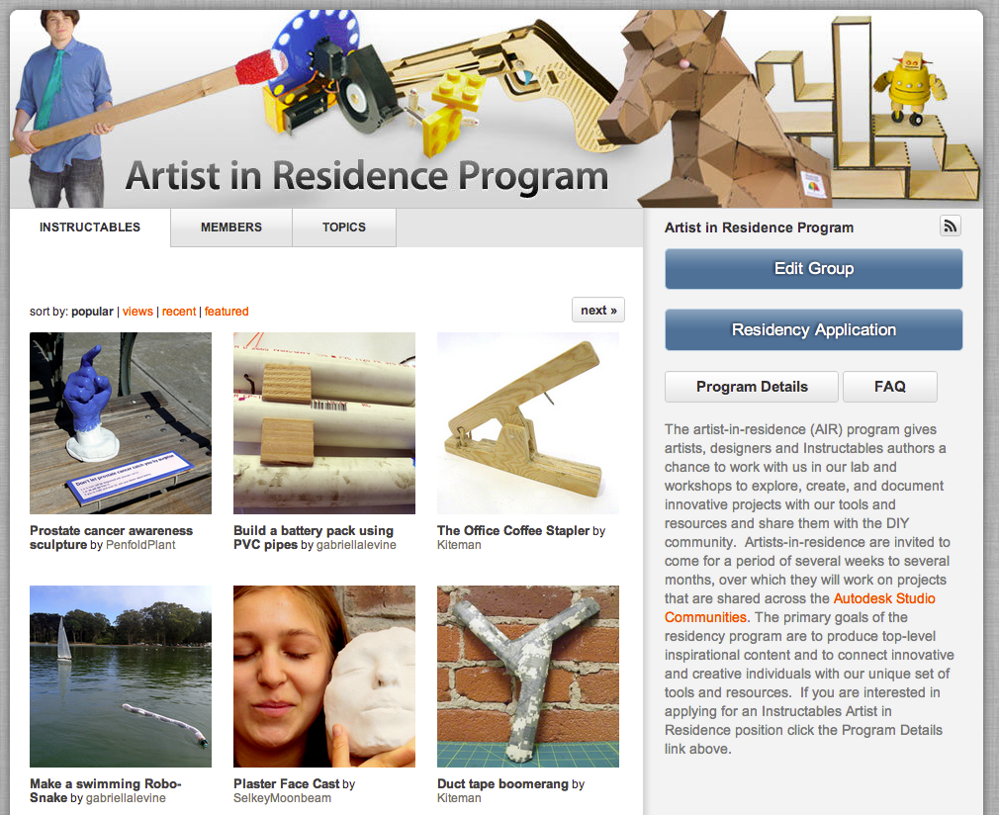
Artist-in-residency
http://www.instructables.com/group/air/
2

