Slide 1
Cisco’s Networking Academy Scale and Approach
Gary Coman
Director – Technical Advocacy
Cisco Networking Academies

Slide 2



Corporate Social Responsibility and Cisco Networking Academy
Large and Global
165 Countries
1 Million Students engaged this year
3.75 Million Students since inception
Diverse
Students and
Communities
Students: Diverse Age, Gender, and Circumstances
Communities: Mature and Developing
Diverse Educational Institutions
Universities Community College Vocational Schools Secondary Schools Non-profit Organizations
Second Chance
Notes:
Cisco Networking Academy is Cisco’s largest CSR program, with an expansive global presence.
We educate over 900,000 unique students within a given year. To compare with education systems in the US, Networking Academy is larger than the California University system in its entirety.
Over the course of our 12 years we have taught over 3 million students and are proud to say we have over 550,000 CCNA certification-ready graduates.
Networking Academy is incredibly diverse:
Students are of all ages, with a strong female contingency and coming from very diverse backgrounds and circumstances
Students range in age from 12 to over 60.
There is a healthy mix of women and men, even though we want to increase the number of women. The global percentage of female students is approximately 20%
People range from those trying to work their way out of the slums in their region, to physically challenged students, to people in prison planning for their future outside
Our communities are equally diverse, including both developing and mature countries, organizations providing a second chance, and a combination of schools ranging from public schools to advanced education institutions
Upper secondary schools represent approximately 14%
2-3 year institutions, such as community and vocational schools, 34%
4 year institutions/universities, 47%
And the remaining schools, 5%

Slide 3
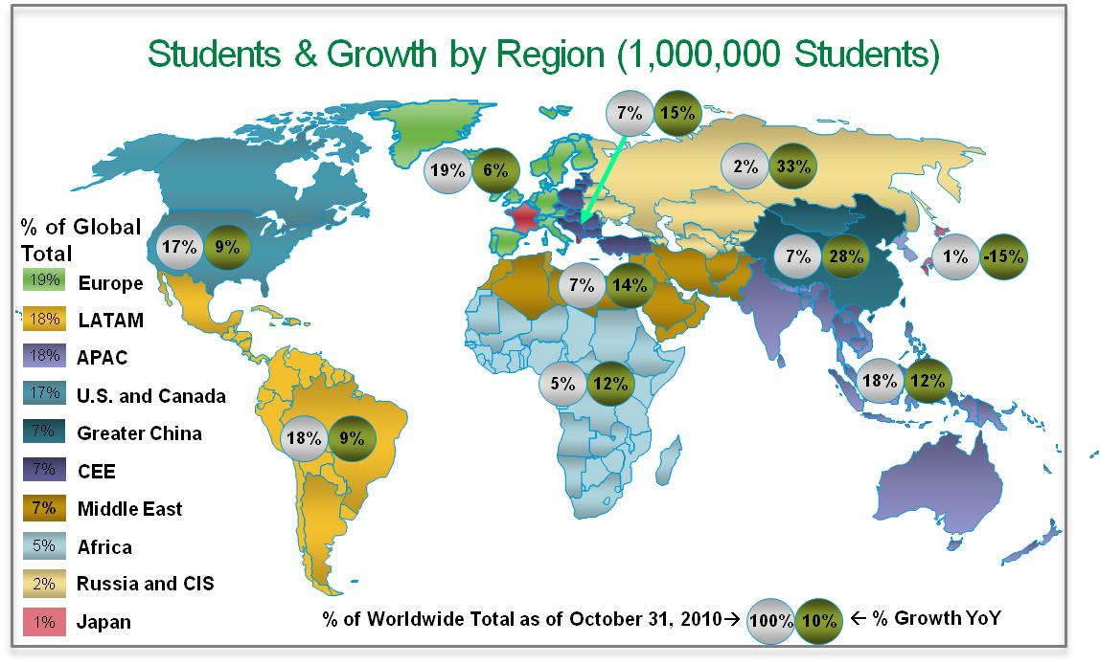

Slide 4
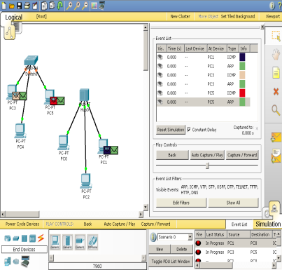

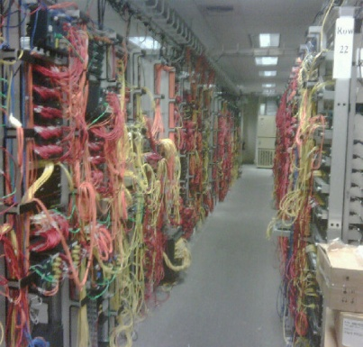
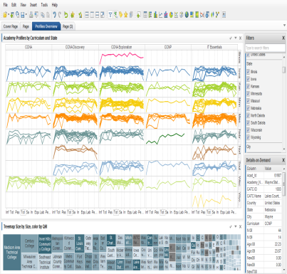
A comprehensive educational partnership
Curricula
Product
Relationships
Students
Academies
Instructors
Governments
Partners
14 courses
Entry-level tech skills
Instructor-led
Simulation and visualization software
Hands-on experience
Assessments
Educational process and learning systems
Larger server base than cisco.com
2.5 terabytes of data
1M assessments/month
Metrics
Services
Support
Infrastructure
Program Design
Notes:
We have come to understand that many people think of Cisco Networking Academy as a curriculum set when in fact it is functionally organized like a company, in order to provide the best possible service to its customers: students, instructors, and academies.
Cisco Networking Academy is a comprehensive approach to education based on 4 key elements:
Curricula
Infrastructure
Relationships
Program Design and Support
Our curricula include 14 courses providing entry-level technical skills to pursue a career path in IT.
Students enjoy a hands-on experience in labs and benefit from Instructor-led training.
The learning model is distinctive in that it offers a combination of online and instructor-led learning, in and out of the classroom.
Another point of differentiation is the assessments that ensure consistent high quality learning worldwide.
We are taking a strategic and managed approach to translation of our courses, aligned with UN standards, to ensure the most efficient execution and optimal local relevance
Our infrastructure is robust – now residing back inside Cisco
2.5 Terabytes of Data are managed
Larger server count than Cisco.com
Approximately 1M+ assessments per month are delivered
Our relationships with our Academies, Instructors, Governments and Partners are vital to success and supported through an eco-system approach to partnership
We are expanding our relationships to include employers who help keep us aware of market opportunities and design our courses accordingly
Our program design and support is highly metrics-driven to ensure the best understanding of how well we are doing in all areas important to Networking Academy success
By taking a segmented approach we are designing our courses to address the specific career goals of our students, and offering skill sets to meet specific market needs.
Rather than simply providing skills for a vocational job, our students are prepared to pursue the IT careers of tomorrow.

Slide 5


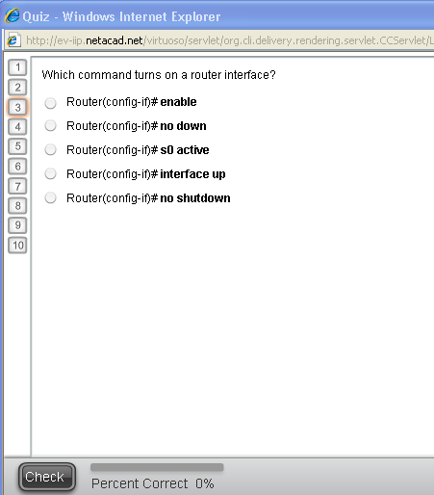

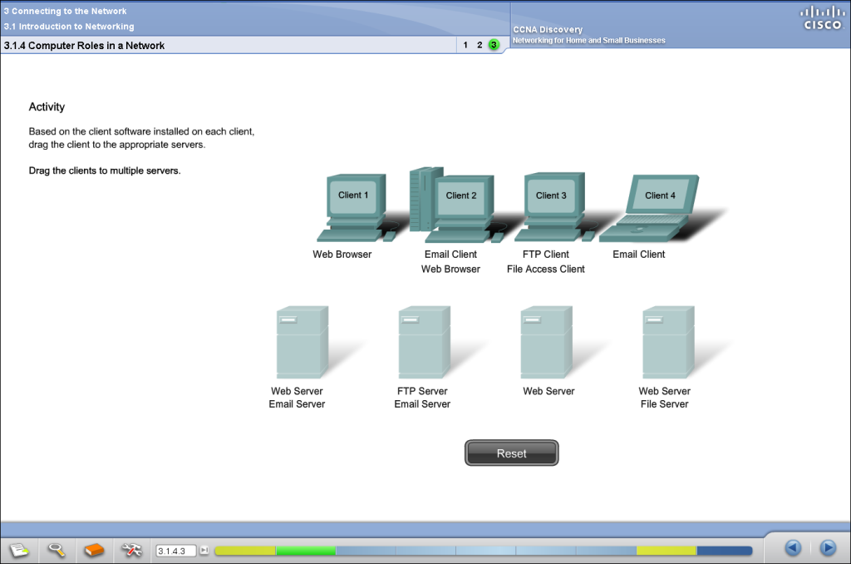
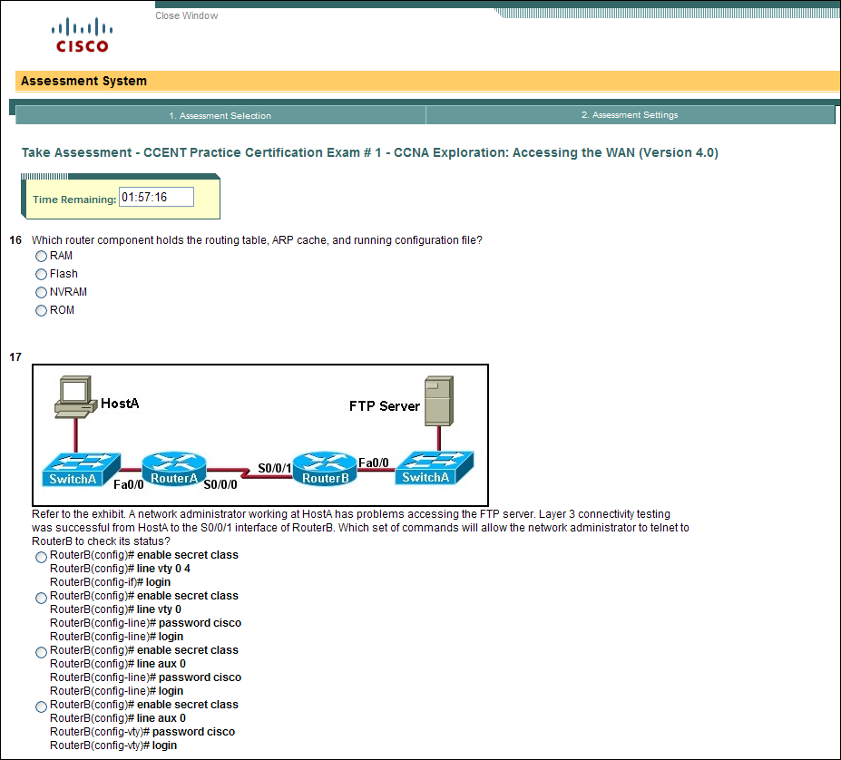
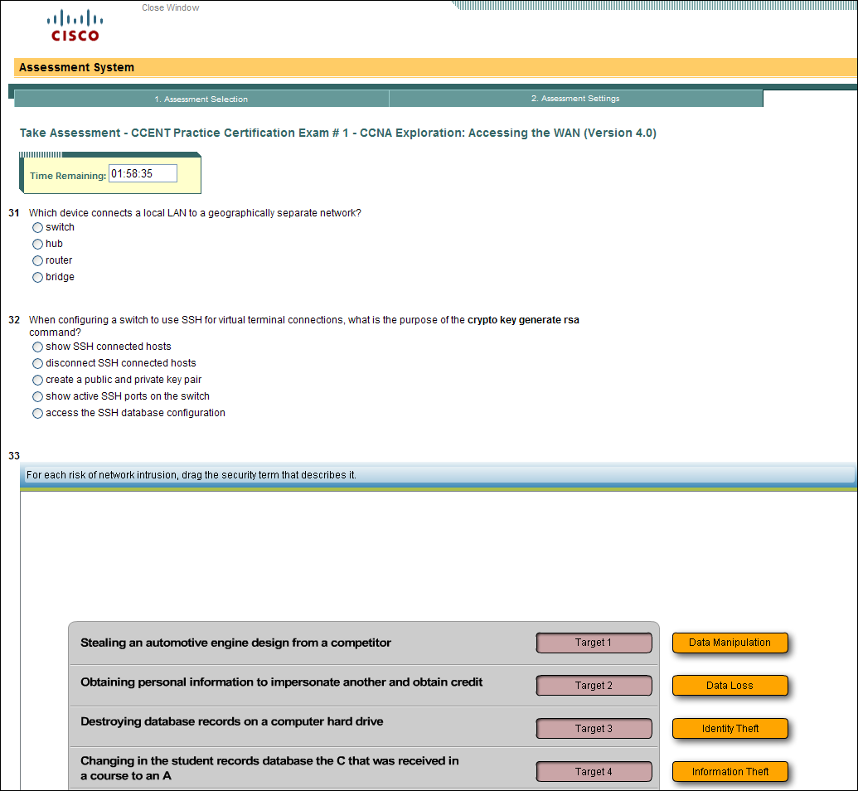
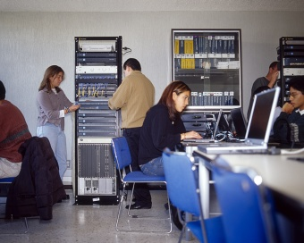
Behrens, J. T., Collison, T. A., & Demark, S. F. (2005) The Seven Cs of comprehensive assessment: Lessons learned from 40 million classroom exams in the Cisco Networking Academy Program. In S. Howell and M. Hricko (Eds.), Online Assessment and Measurement: Case Studies in Higher Education, K-12 and Corporate. (pp 229-245). Hershey, PA: Information Science Publishing.
Frezzo, D.C., Behrens, J.T., & Mislevy, R.J. (2009). Activity theory and assessment theory in the design and understanding of the Packet Tracer ecosystem. The International Journal of Learning and Media, 2. http://ijlm.net/knowinganddoing/10.1162/ijlm.2009.0015

Slide 6
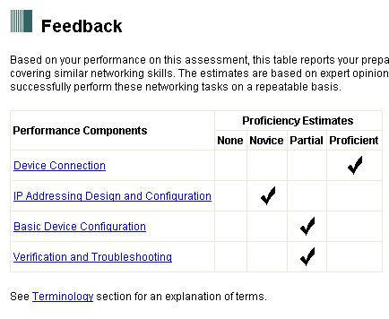
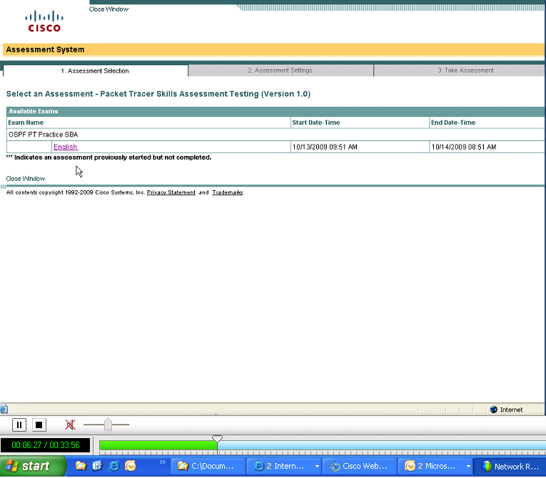
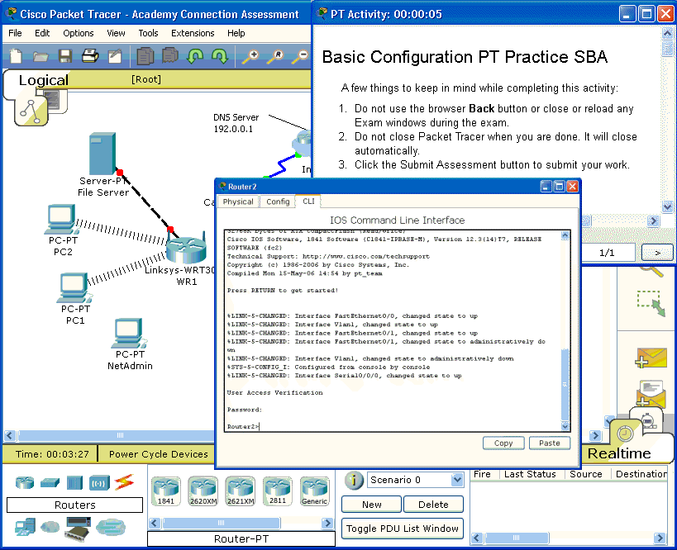
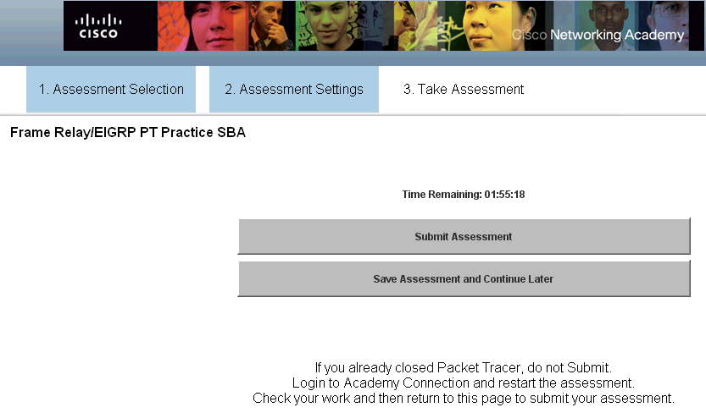
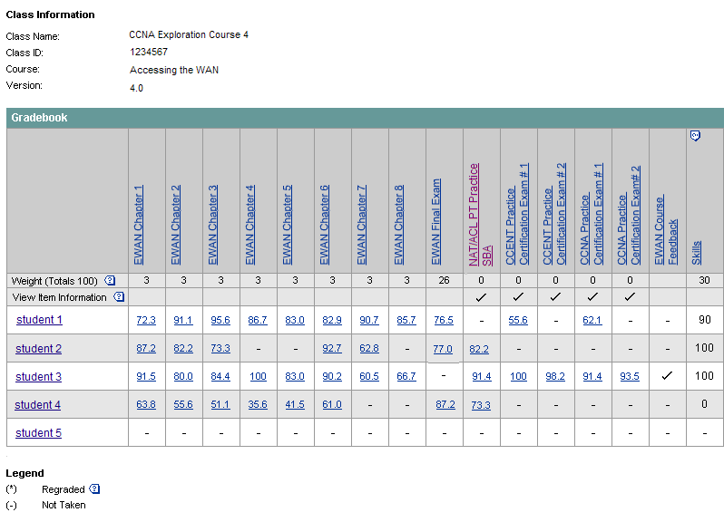

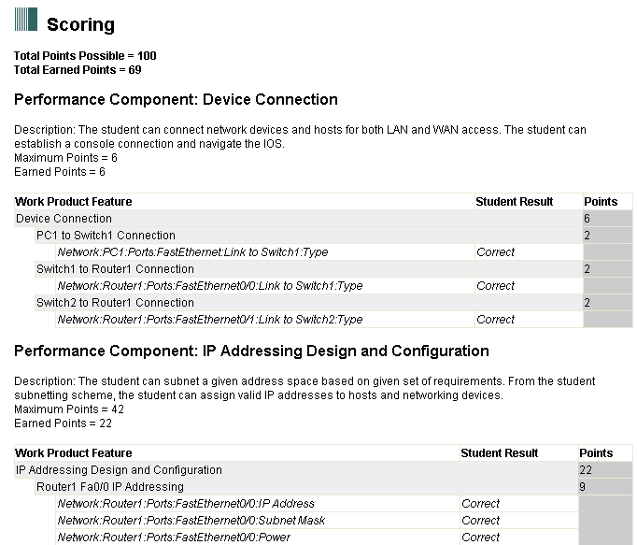


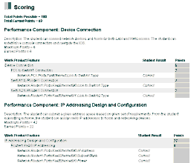
Using the best of each approach: PT SBA
Launch
Take Exam
Submit It
Automatically
Scored
View
Feedback
1
2
3
4
5
© 2008 Cisco Systems, Inc. All rights reserved.
Cisco Confidential
6
Notes:
6
6
The flexibility of the new scoring model allow the necessary richness to recreate the thinking of extended integrated activities

Slide 7
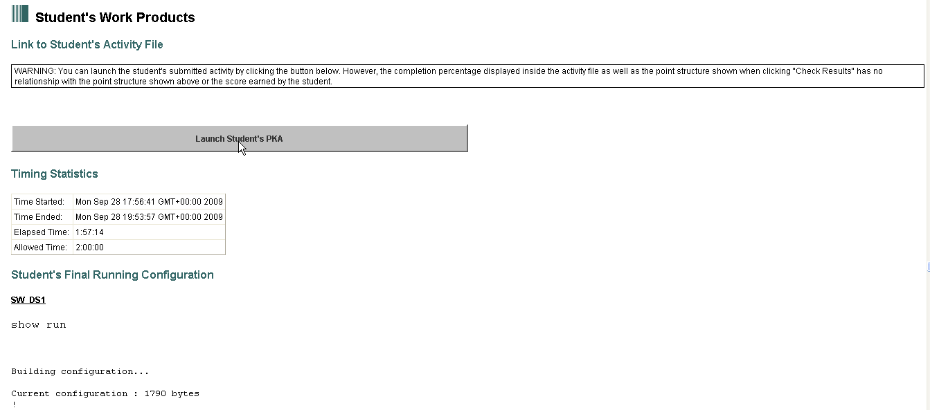
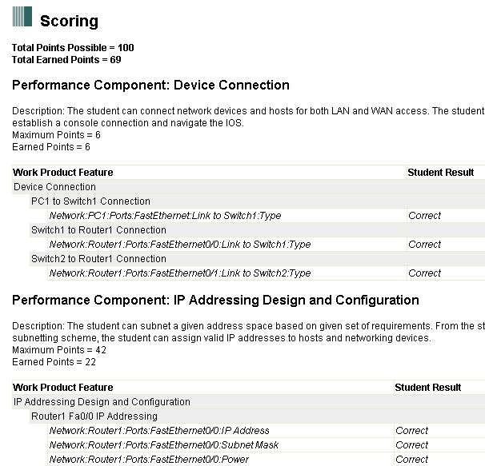
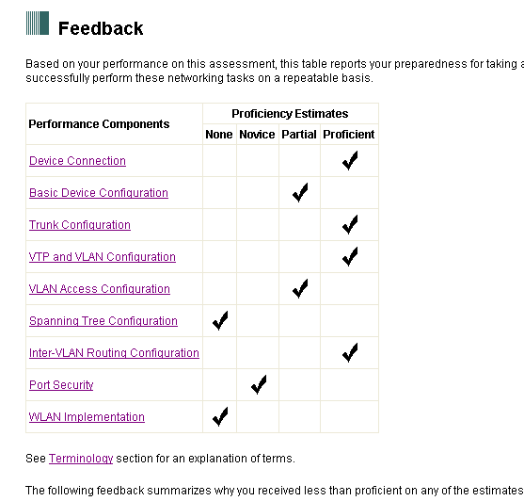
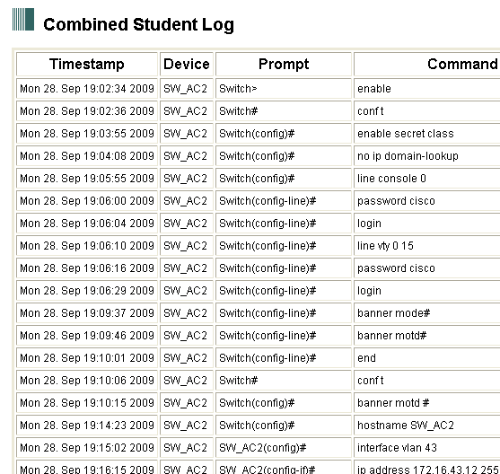
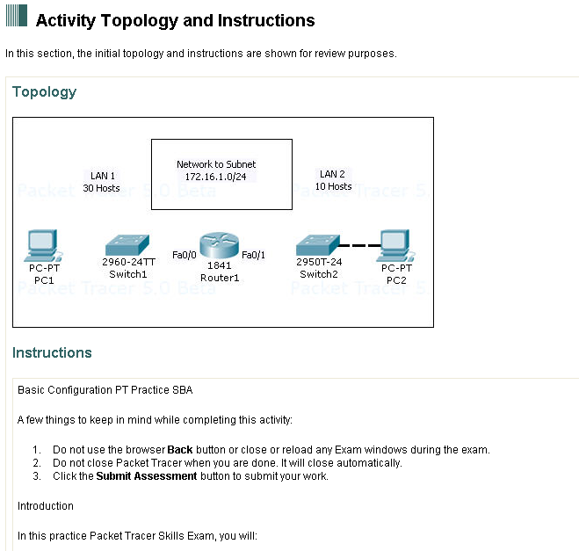
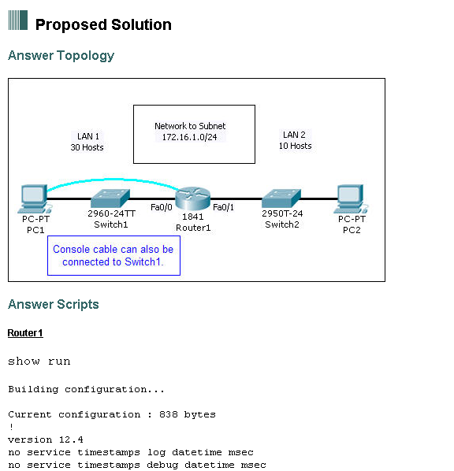

Detailed Environment Provides Detailed Feedback
Access Student Work Product
Time Stamped Student Log
Proficiency Estimates
View Activity
Detailed Scoring Feedback
View Proposed Solution
© 2010 Cisco Systems, Inc. All rights reserved.
Cisco Public
7
© 2010 Cisco Systems, Inc. All rights reserved.
Cisco Public

Slide 8
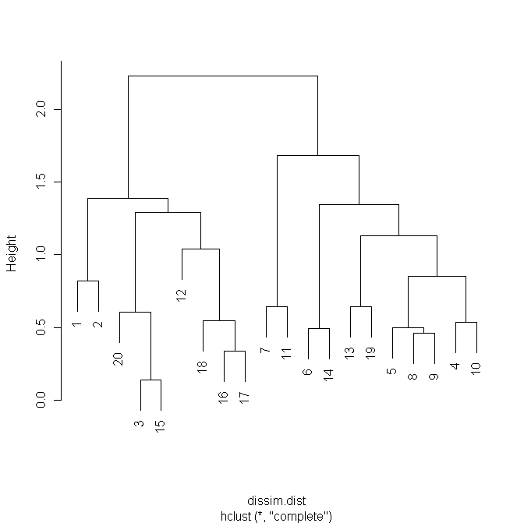
Application of SNLP & Document Retrieval Strategies for stream analysis
We can see which “documents” are most like other “documents”

Slide 9
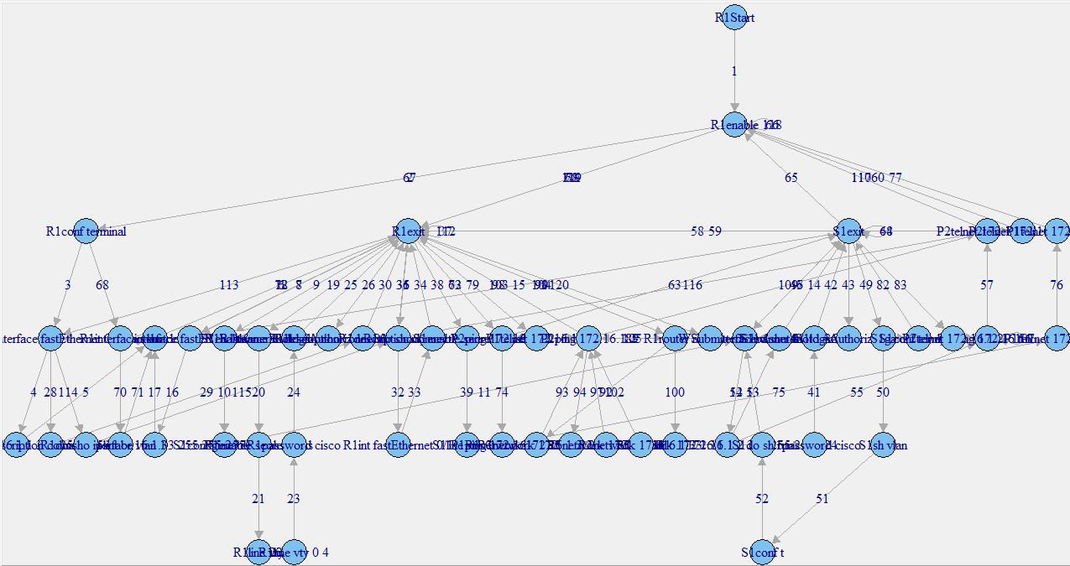
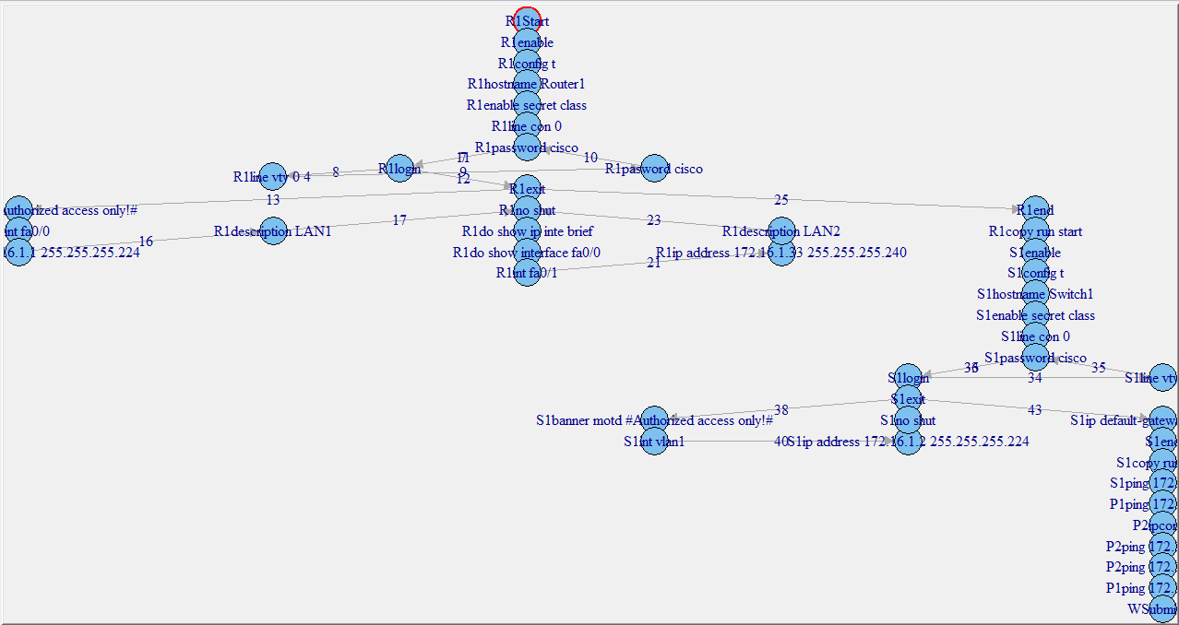
EDA and visualization

Slide 10
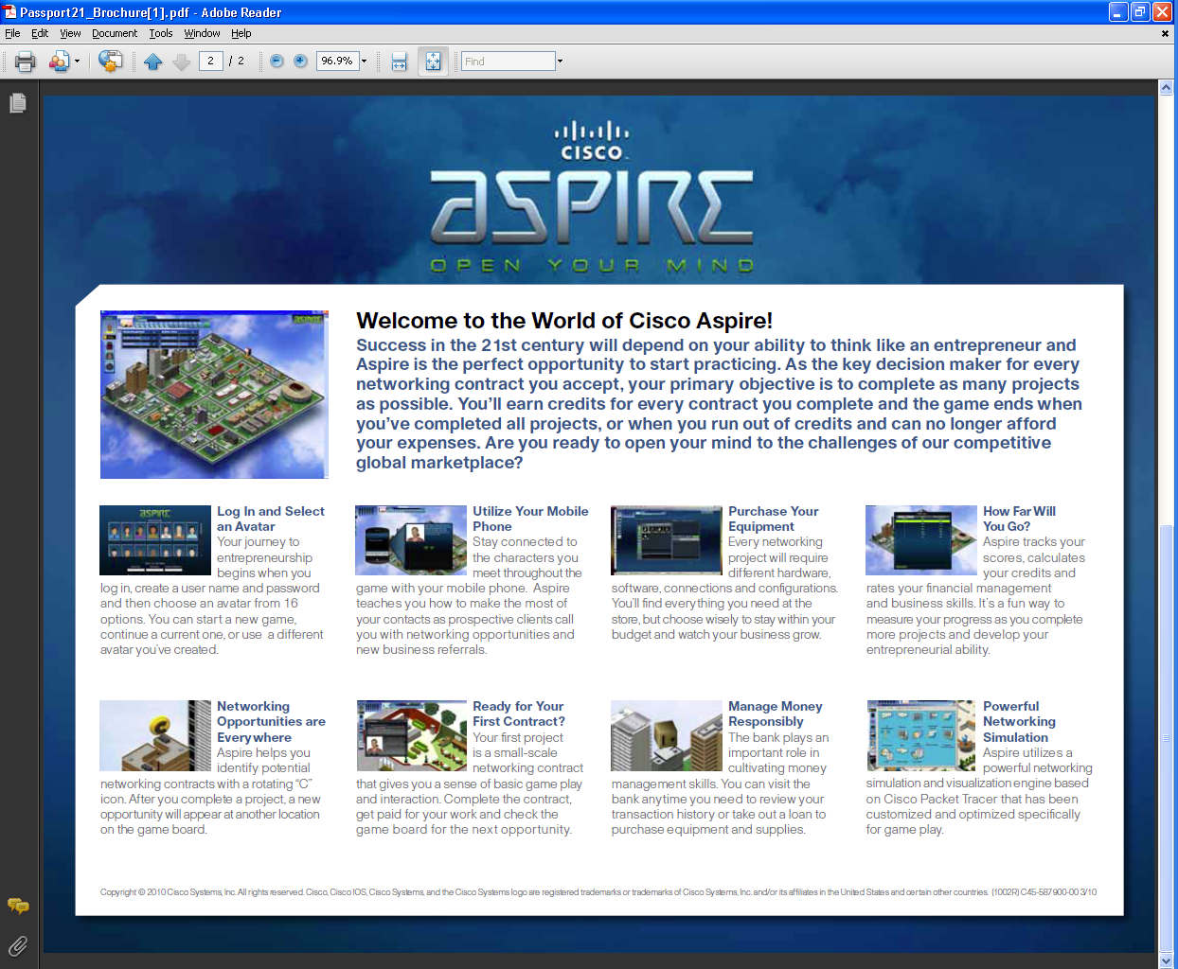
PT + Assessment + Game Layer => Aspire
Behrens, J. T., Frezzo, D. C., Mislevy, R. J., Kroopnick, M., & Wise, D. (2007). Structural, Functional and Semiotic Symmetries in Simulation-Based Games and Assessments. In E. L. Baker, J. Dickieson, W. Wulfeck, & H. F. O'Neil (Eds.) Assessment of Problem Solving Using Simulations (pp. 59-80). New York: Erlbaum.

Slide 11
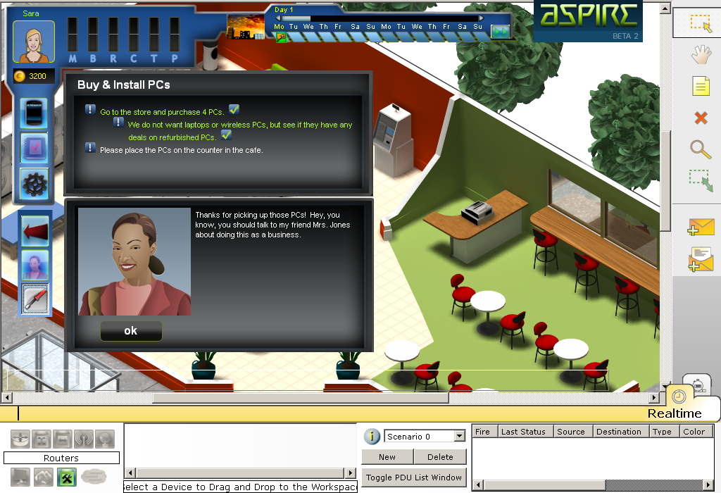

Slide 12
Proficiency Dimension | Example evidence
Business Sense | appropriate choice of new vs. refurbished equipment
Network Configuration | home wireless settings, setting device IP addresses
Money Management | bill payment
Physical Labor | buy & place devices, connect cables
Troubleshooting | diagnose and repair network errors
Reputation | completeness of installation (going beyond minimum)

Slide 13
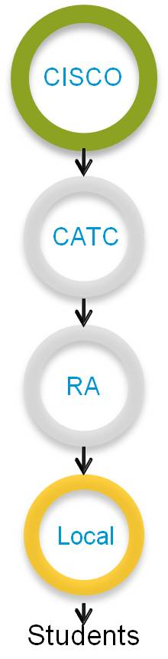
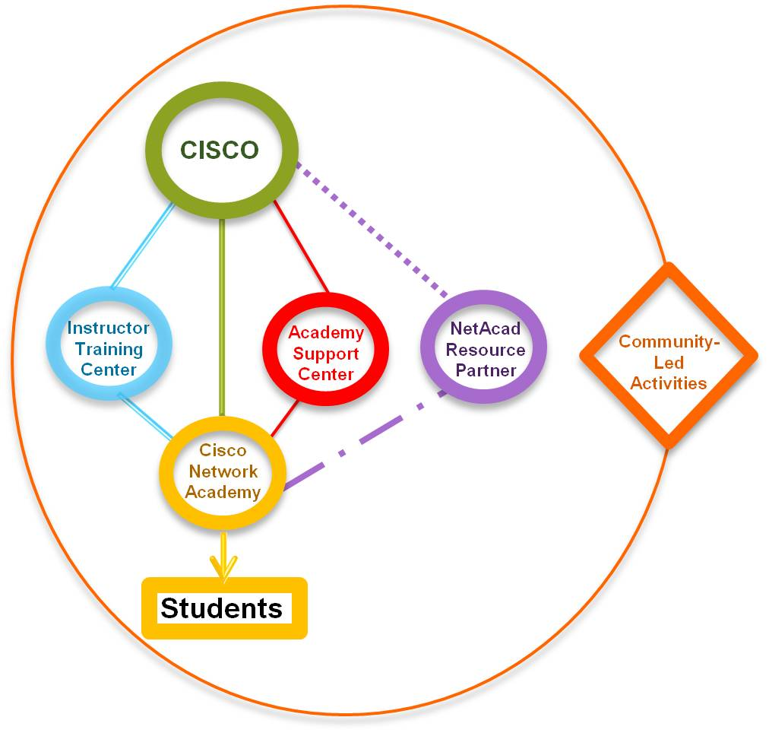
Partner Model: Current and Future
Current Model
Future Model
Successful yet limited in:
collaboration opportunities
scalability
Closer relationship between Cisco and Academies
Specialized institutions
Enable more effective and sustainable partnerships
Recognition of increased community role
Notes:
As you can see, here we have a side by side representation of the current architecture and the new architecture we will be testing.
You’ll notice a new institution called, Academy Support Center
The Academy Support Center is designed to ensure that the Academy receives the right level of communications and support on baseline services – the people that this entity will support are the administrators at the Academy. Without this support in the biz architecture there is no ecosystem partner focused on supporting those roles.

Slide 14


