Slide 1
Recoding the Genome
Peter Carr
18 August 2011
FAB7
Lima, Peru

Slide 2
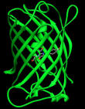
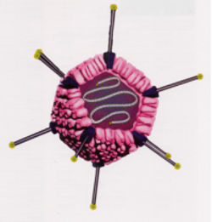
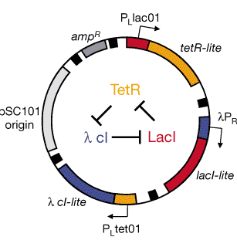
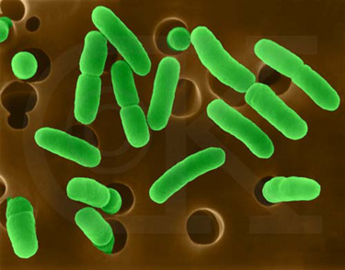
DNA On-Demand
rewrite genomes
minimal life
genetic circuits
metabolic pathways
DNA
base
pairs
10³
10⁴
10⁵
10⁶
vaccines
gene therapy
individual genes
assembly
scaffolds

Slide 3
How big can we go?
10000000
1000000
100000
biology
10000
nucleotide bonds
1000
biochemistry
100
10
organic chemistry
1
1950
1960
1970
1980
1990
2000
2010
2020
year
Carr & Church (2009) Nature Biotech.

Slide 4
The basic genetic code
64 words
(codons)
4 letters
4 letters
4 letters
AAA
AAC
AAG
AAT
ACA
ACC
ACG
ACT
...
A
C
G
T
A
C
G
T
A
C
G
T
X
X
=

Slide 5
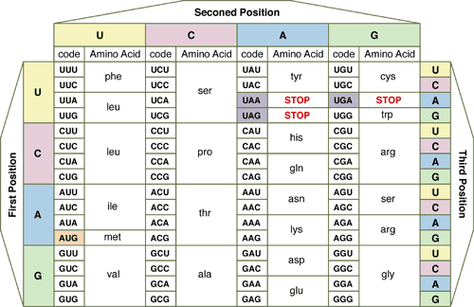
Second Position

Slide 6
Second Position
new room
for plug &
play
rearrange
to block
function
By engineering new genetic codes we can:
make universal systems for “plug and play” with new amino acids
block exchange of genes, a “genetic firewall”
produce organisms immune to viruses

Slide 7
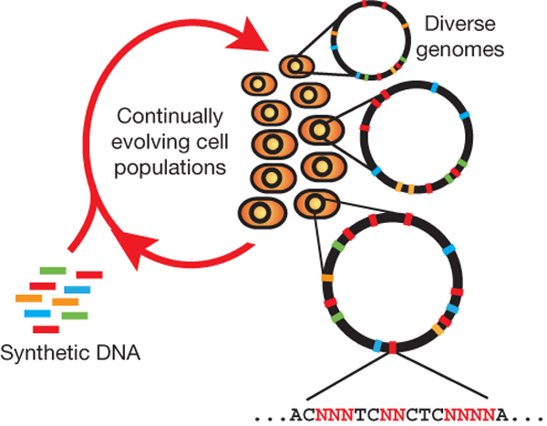
Multiplex Automated Genome Engineering (MAGE)
“Find and replace” with the DNA of the genome

Slide 8
Key features of MAGE:
Multiplexed: can address many sites at once
Targeted: modifies specific sequences; changes made can be specific or random
Iterated: weak efficiency can be compensated by automating many cycles of modification
Tunable: can control the range of diversity generated in a population
Clean: no DNA scars, no resistance gene markers, etc.

Slide 9
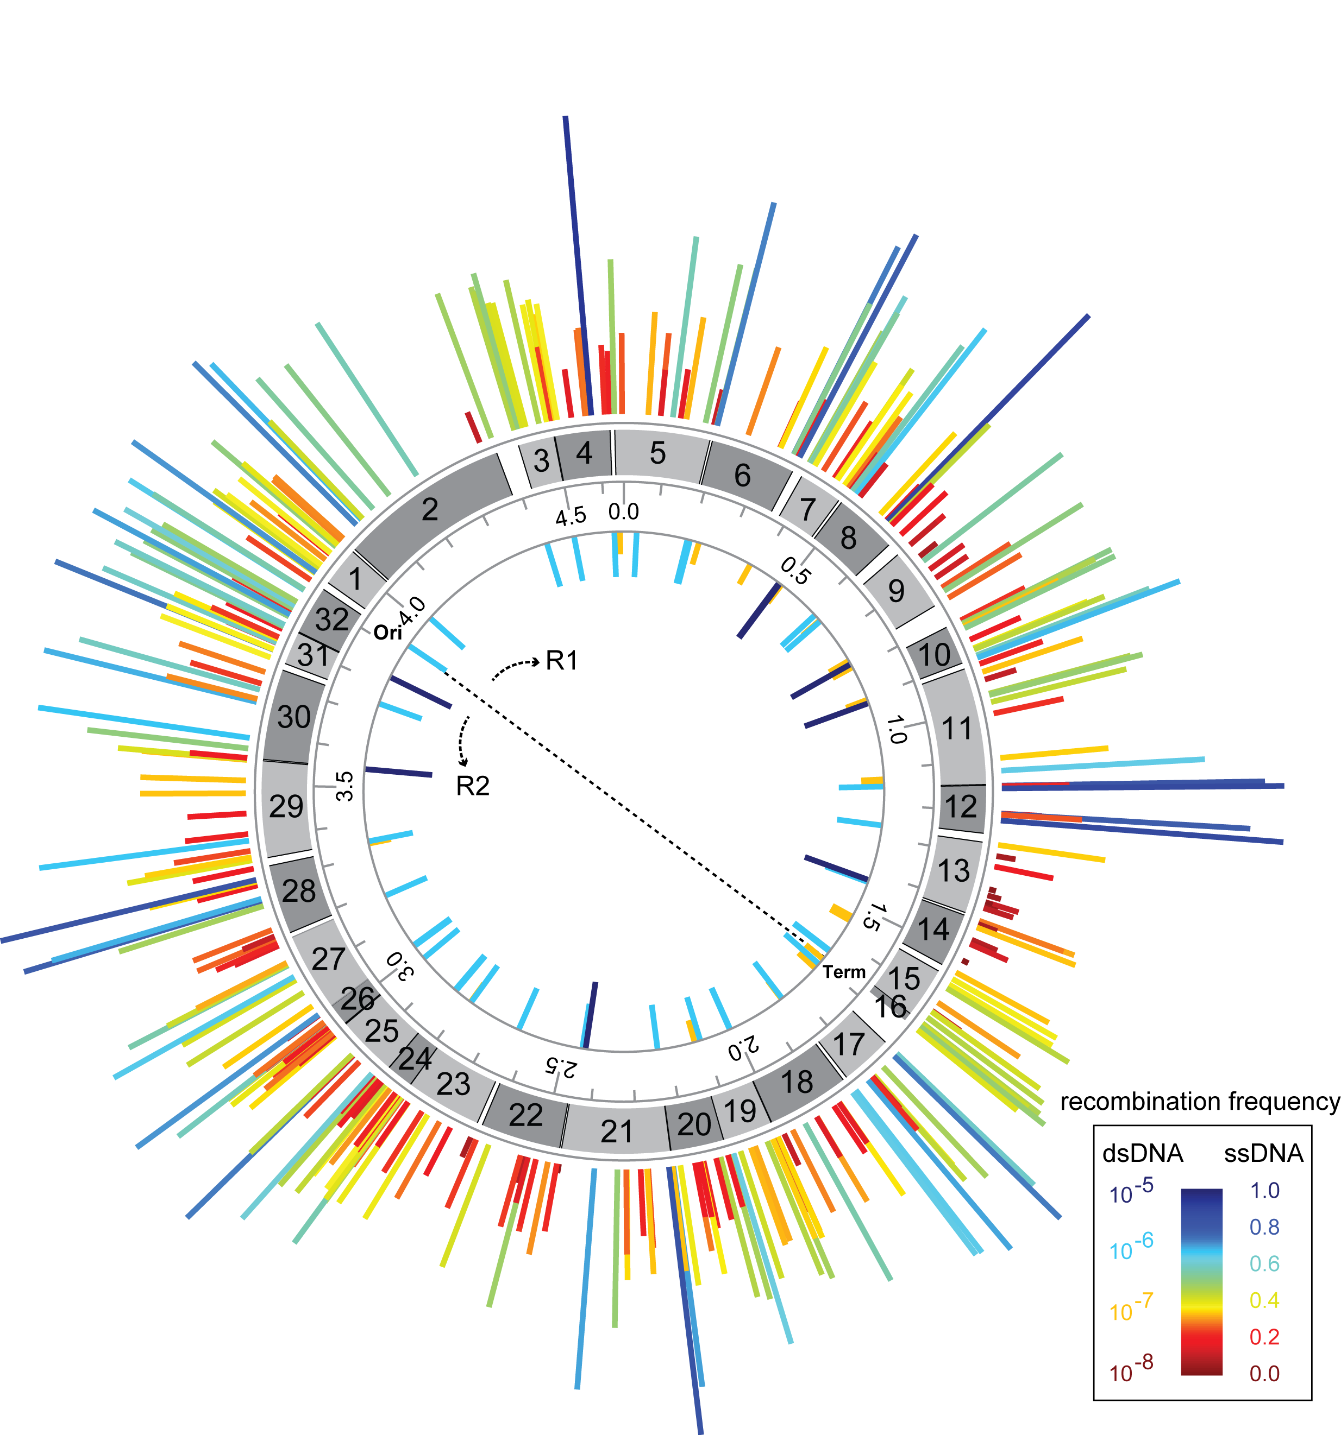
All 314 sites in the genome modified
(across 32 strains)

Slide 10
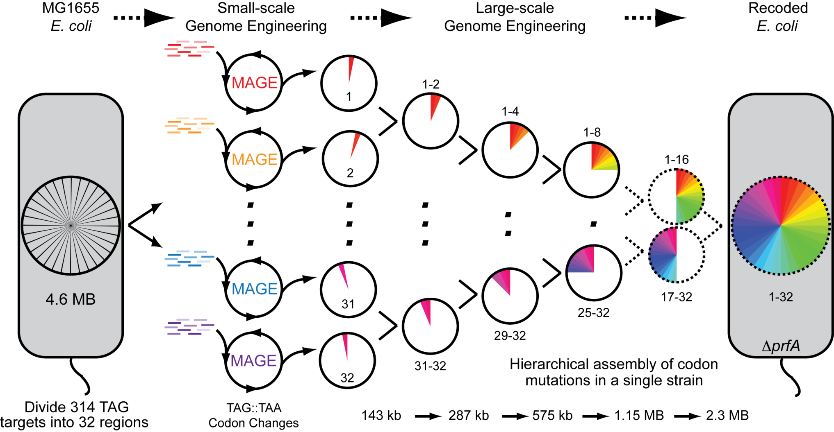
Genome Engineering base pairs to megabases

Slide 11
Thanks to:
Joseph Jacobson
Bram Sterling*
Chris Emig
Sam Hwang
George Church (HMS)
Farren Isaacs
Harris Wang
Marc LaJoie
Shuguang Zhang (MIT)
Funding: NSF

Slide 12

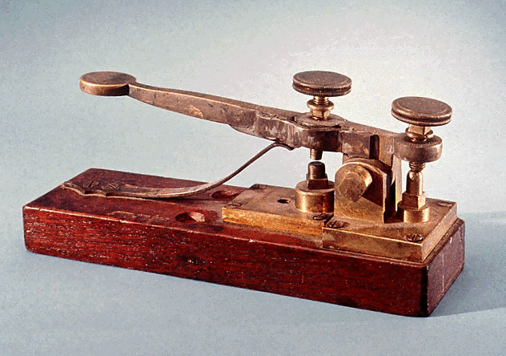
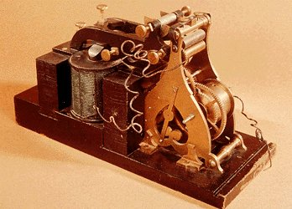
Atoms to bits...to atoms to bits
transmitter
receiver
genetic counseling
molecules
health statistics
me
Box 1
G
A
T
T
A
C
A
Box 2
clinical + research data
you
forensics
it
basic research
experiments

Slide 13
Personal
Box 1
Box 2
MY GENES
MY TREATMENT
How will drugs X, Y, Z affect ME?
How will MY BODY metabolize drugs X, Y, Z?

Slide 14
Community
Box 1
Box 2
NEW PATHOGEN
RAPID RESPONSE
Analyze the PARTS
Test existing DRUGS at many sites
Preliminary VACCINE

Slide 15

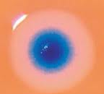
Creativity
Box 2
MY IDEA
MY DESIGN FOR...
new vaccines
novel organisms
new biochemistry
DNA nanostructures

