Slide 1


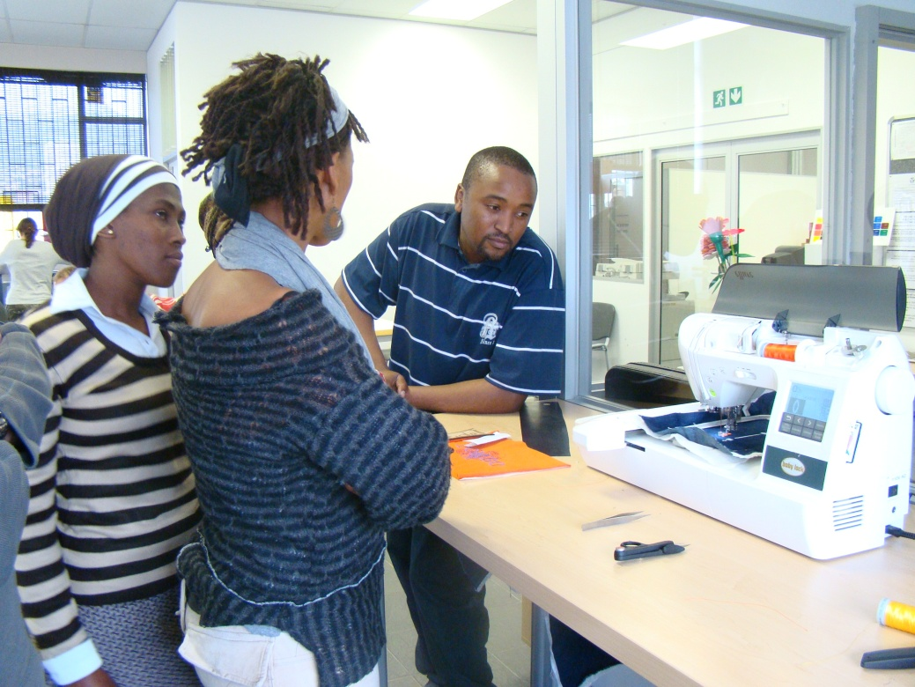
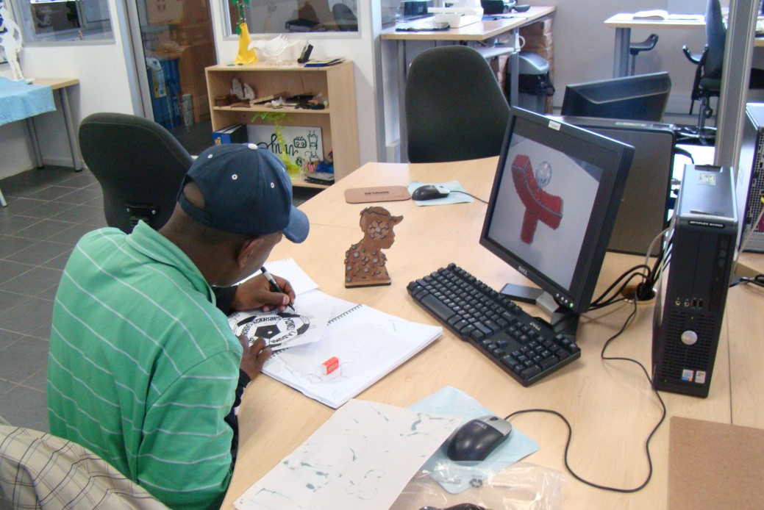
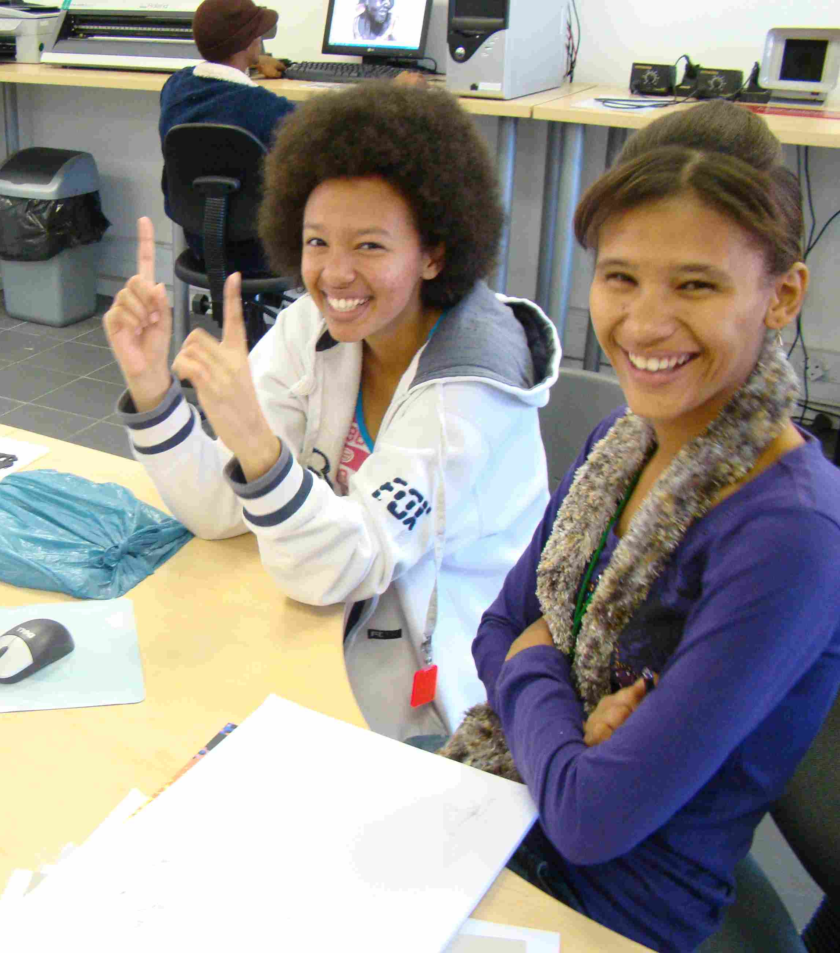
Cape Town
Above: Workshop participants monitor the digital embroidery machine.
Above: Craft producer Phillip Mbusi puts the finishing touches on a prototype
Location: 75 Harrington Street
Cape Town, South Africa
Launch date: 30 May 2006
Present at Fab5: Pieter Cilliers - FabLab Facilitator
Alan Alborough - CCDI Creativity, Design & Innovation Programme Manager
Contact: fablab@ccdi.org.za
Left: FabLab assistant Tracy Semmenlink shows a workshop participant that it’s all about accurate measurements.

Slide 2
Cape Craft and Design Institute
AMTS FabLab
Cape Town
Users and target areas
engineers
mechatronics
artists
product developers
fine art
electronic
Students
General Public
fashion
entrepreneurs
graphic design
architecture
designers
inventors
industrial design
woodwork
decor
mechanical engineering
fashion
jewellery
school learners
Craft Producers
furniture
surface design
accessories
textiles
lighting
beadwork
toys
curios
wirework
ceramics

Slide 3
